Slide 1
50HP Propeller Project Detailed Report
GloTech Corporation
Prepared by: Joshua Rogers & Mark Gu
2021-2022

Slide 2
Contents
Project Proposal
Project Background, RE-DO Process, Design Analysis
Diagnosis, Proposed Next Steps, Timeline
Design Optimization
Project Background, Methodology, Conclusions
Design Update with Prototype testing data
Achieved balancing, Too efficient lowering Power draw.
Final Product Testing & Project Close
2

Slide 3
Project Background
Customer engaged GloTech to analyze their existing 50HP aerator propeller, and to provide an improved design solution
Customer reported the following issue on their existing 50HP prop:
Hydraulic vibration: Excessive vibration during aerator operation under water. Top bearing “wears out unevenly”
The project goal is for GloTech is to analyze the above mentioned issue and provide an improved design with the following features and benefits:
Improved product quality: reduced vibration, better casting quality and uniformity
Product differentiation: potential cost savings, pre-pitched and balanced prop, optional addition of customer LOGO / cast letters
The preliminary design of the 50HP propeller has been completed using GloTech’s RE-DOTM (Reverse Engineering and Design Optimization) process. Preliminary timeline and fees to be provided based on the above
3

Slide 4
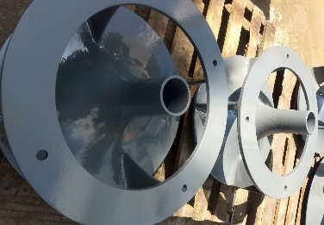
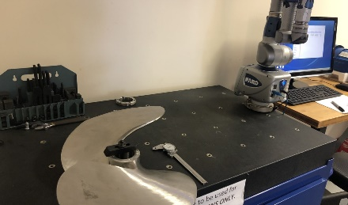
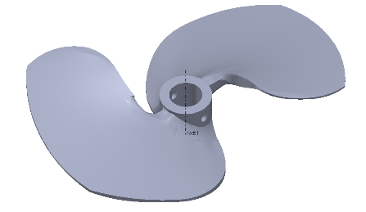
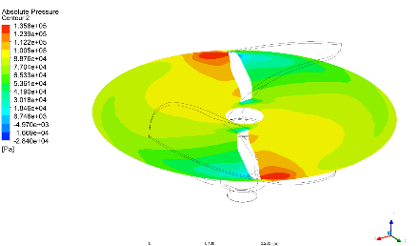
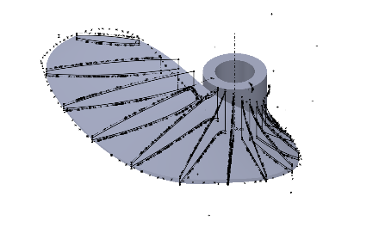
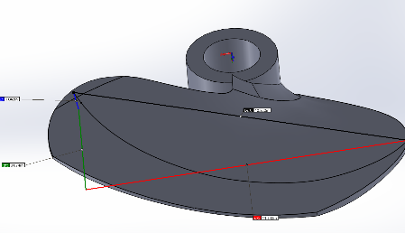
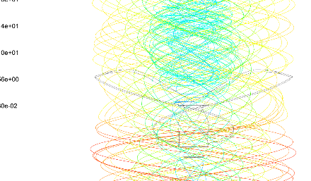
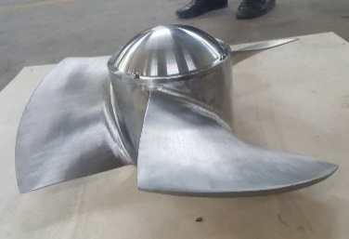
RE-DO Process
Our RE-DOTM (Reverse Engineering and Design Optimization) process is used to create the 50HP propeller solution
GloTech RE-DOTM Process for 50HP Propeller
Scanning
Modeling
Optimization
Manufacturing
3D scan sample propeller using FARO technology
Create and analyze 3D models in SolidWorks
Improve design using GT’s hydraulic expertise
Next Step: provide turnkey product solution
4

Slide 5
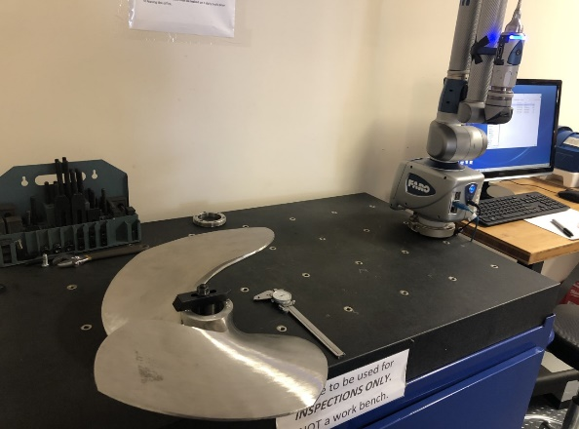
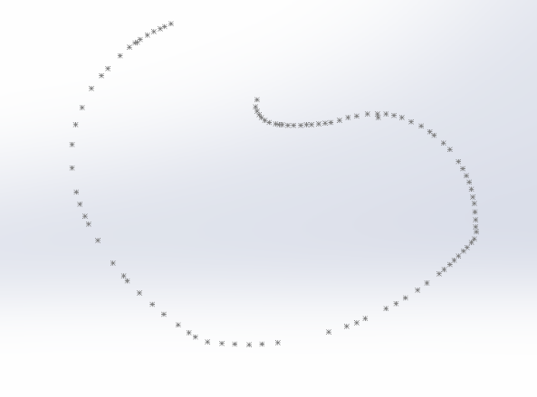
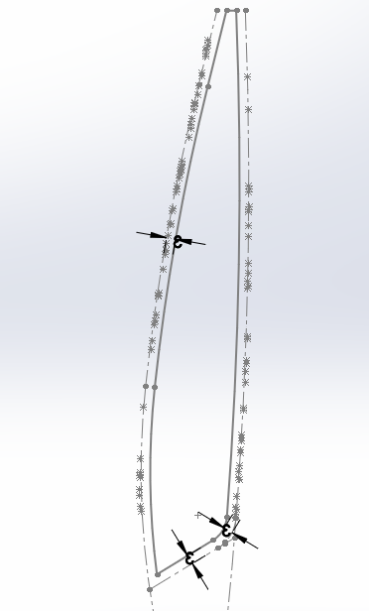
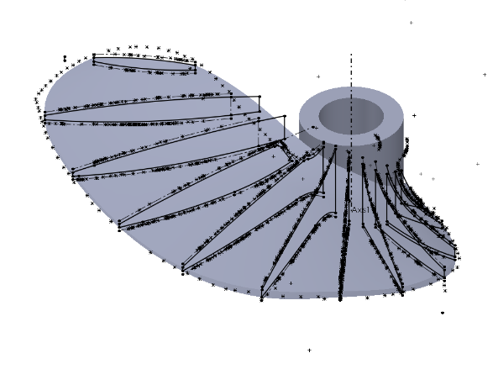
Propeller Scan Using FARO
The sample 50HP propeller from customer was first scanned into SolidWorks using FARO Arm
Alignment was performed to set the correct position of the prop
Blade boundaries were scanned in to establish blade contour
12 cutting planes were created to acquire the cross-sectional geometry of the blade
Blade profile was created using previously collected data points
Scanning Techniques
FARO scan setup
Blade Boundary Contour
Sample Scanned Plane
Blade Geometry Construction
5

Slide 6
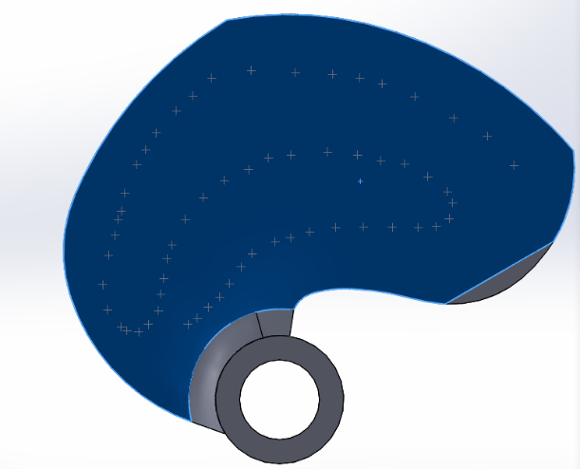
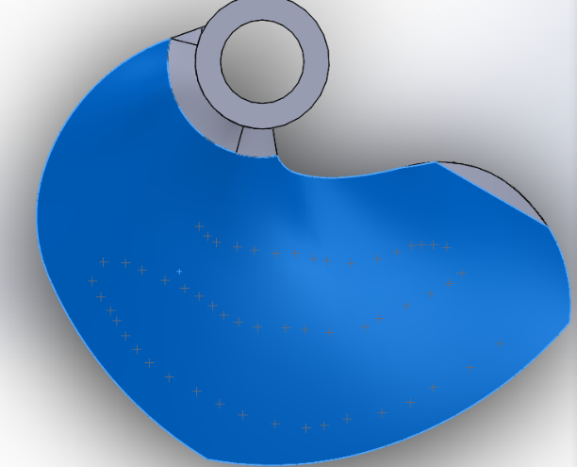
Part Validation
Blade model was compared against sample part using FARO validation
Top Validation (unit: mm)
Bottom Validation (unit: mm)
Point Cloud
X | Y | Z | Deviation
150.3413 | -38.9888 | 150.4208 | 0.0745
133.5606 | -33.3474 | 169.349 | 0.1364
111.7944 | -27.8062 | 181.015 | 0.0272
86.7772 | -21.4215 | 194.7289 | 0.0274
65.8505 | -16.2446 | 202.9589 | -0.0633
51.2429 | -12.7596 | 206.6299 | -0.12
34.03 | -8.6927 | 209.2321 | -0.1878
10 | -3.3076 | 209.9754 | -0.0297
-18.0717 | 3.0193 | 211.6113 | -0.0097
-43.5731 | 8.722 | 206.8293 | -0.0758
-55.735 | 11.8213 | 195.2327 | 0.0035
-66.3004 | 14.8423 | 185.6657 | 0.0233
-79.1126 | 19.1817 | 171.4066 | 0.0158
-86.1415 | 22.2797 | 160.5803 | -0.0796
-91.976 | 25.0642 | 150.9584 | -0.0475
-99.6489 | 29.9499 | 132.518 | 0.15
X | Y | Z | Deviation
146.0773 | -19.4242 | 173.0193 | -0.6069
127.7089 | -14.4833 | 187.7654 | -0.4704
105.1841 | -8.2066 | 199.96 | 0.0469
90.9045 | -4.8876 | 209.2368 | 0.1372
73.5702 | -1.3309 | 215.4908 | -0.4255
52.3297 | 3.1147 | 219.1453 | -1.0911
38.1636 | 5.8429 | 223.3163 | -1.0778
27.0685 | 8.5162 | 224.5939 | -0.7798
7.824 | 13.6025 | 221.999 | -0.5702
-11.9688 | 19.0114 | 216.5942 | -0.5142
-25.986 | 23.2494 | 209.7597 | -0.5164
-40.4024 | 27.4533 | 202.1779 | -0.4588
-57.1958 | 31.3304 | 193.6295 | -0.5956
-69.354 | 34.4466 | 184.7651 | -0.3615
-76.9332 | 36.9995 | 176.6638 | -0.0426
-84.1592 | 39.4568 | 168.0845 | 0.0812
Top Validation
Validation results indicate the scan is accurate and the blade model is in line with the physical part
Bottom Validation
6

Slide 7
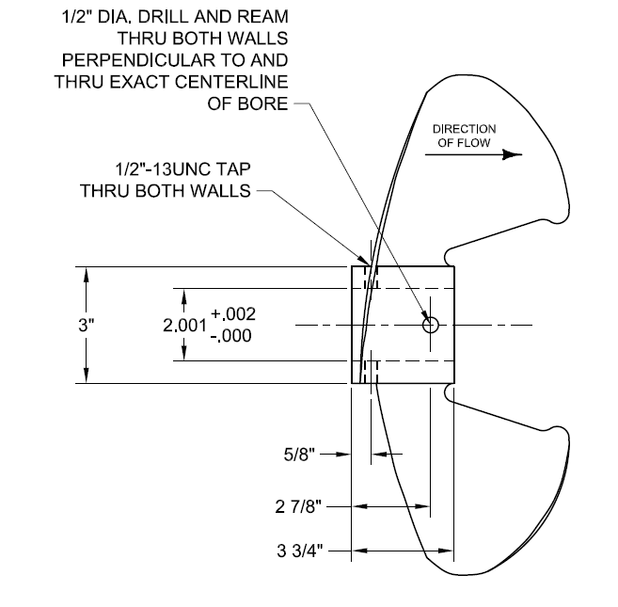
Propeller Design Analysis
The first step of the analysis was to compare the scanned model to the drawing and specifications provided by Customer
Sample Prop vs. Customer Drawing
Description | Drawing | Sample
Casting dia. | 22” | ~21”
Clipped Dia. | 19.5” | ~19.48”
Finish Pitch | 12.0” | 12.05” Avg.
Rotation | LH | LH
Hub Length | 3.75” | 3.20”
Hub Dia. | 3.0” | 3.25”
Weight | 36 lbs | 38.3 lbs
Customer Drawing of 50HP Propeller
Both the prop diameter and pitch measurements are nearly identical to the customer drawing
The hub profile is somewhat different. However, this should have limited impact on the prop performance
7

Slide 8
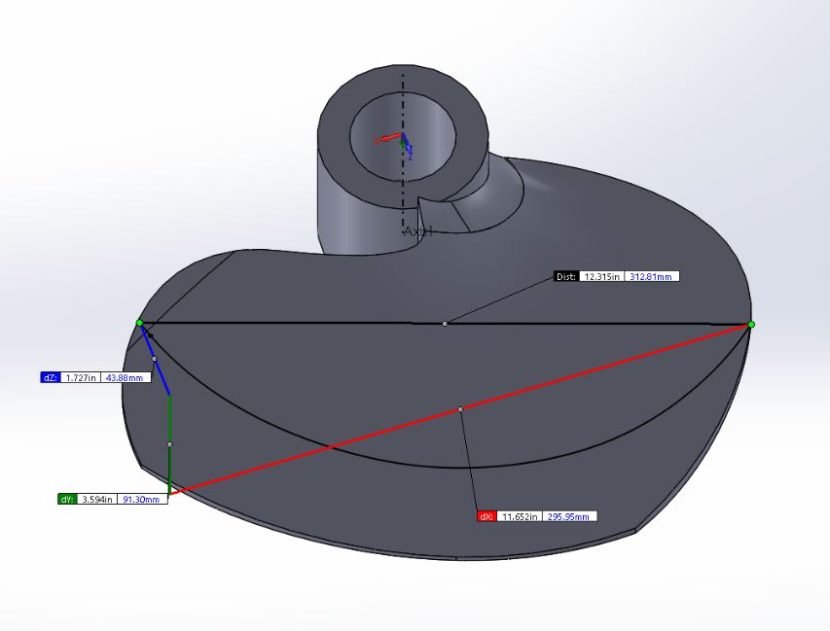
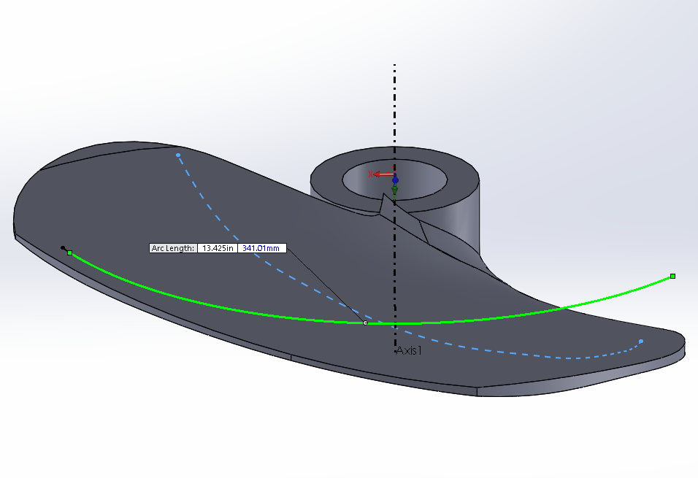
Sample Pitch Measurement
Sample propeller pitch was carefully measured at multiple locations
Pitch = ΔH * [(π * D_{i}) / width]
Where ΔH = change in height
D_{i} = diameter at which pitch is measured
Width = projected arc length
Width
ΔH
The pitch is how far the prop will move with one revolution and is calculated using the formula above.
8

Slide 9
Sample Pitch Measurement – Cont’d
Calculated pitch value at multiple locations of the diameter
Sample Propeller Pitch Measurements
Location | Diameter | Height | Width | Pitch
40% | 19.483 | 3.702 | 8.856 | 10.23445
45% | 19.483 | 4.229 | 10.212 | 11.40631
50% | 19.483 | 4.446 | 11.38 | 11.95647
55% | 19.483 | 4.397 | 12.069 | 12.26461
60% | 19.483 | 4.271 | 13.066 | 12.00449
70% | 19.483 | 3.874 | 13.85 | 11.98433
75% | 19.483 | 3.594 | 13.699 | 12.0436
80% | 19.483 | 3.24 | 13.203 | 12.01623
85% | 19.483 | 2.926 | 12.61 | 12.07213
90% | 19.483 | 2.524 | 11.863 | 11.72042
As shown from the calculations above, the pitch value is relatively consistent across multiple percentages of the diameter, except for areas near the hub
9

Slide 10
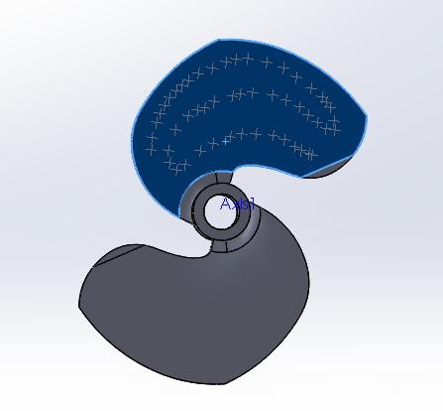
Blade-to-Blade Comparison
The next step is to compare the scanned blade against the other blade on the sample propeller
Top Comparison (unit: mm)
2nd Blade
X | Y | Z | Deviation
106.2167 | 40.0115 | -89.3186 | 1.2007
103.5906 | 33.8086 | -112.318 | 1.3125
94.6052 | 27.5565 | -133.353 | 1.0286
81.6194 | 20.8285 | -153.576 | 1.1327
66.5769 | 14.8813 | -171.898 | 1.1854
54.2846 | 10.6247 | -182.884 | 1.5685
29.8359 | 4.1051 | -197.883 | 1.7053
10.9684 | -0.4559 | -205.961 | 1.8457
-11.1355 | -5.4726 | -211.094 | 1.8535
-35.6781 | -11.3377 | -212.087 | 2.1827
-60.0248 | -16.966 | -206.518 | 2.1297
-80.9451 | -21.8388 | -201.534 | 2.2437
-96.1612 | -29.6654 | -156.613 | 1.8706
-67.2138 | -21.4988 | -163.744 | 1.5272
-29.5286 | -11.2463 | -165.239 | 1.6053
4.6716 | -1.3722 | -159.383 | 1.7883
33.4199 | 7.9723 | -143.602 | 1.7832
Scanned Blade
Top Surface Comparison
Positive deviation on the top surface indicates that the scanned blade is higher than the other blade. Max. amount of shift is 2.24mm (0.088”)
10

Slide 11
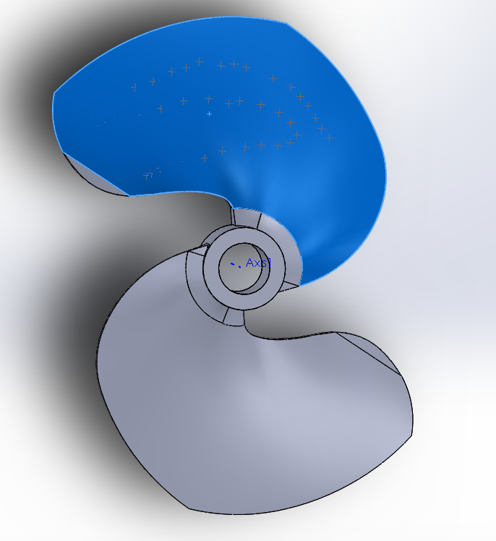
Blade-to-Blade Comparison – Cont’d
Blade comparisons on bottom surfaces
Bottom Comparison (unit: mm)
2nd Blade
X | Y | Z | Deviation
80.4378 | 46.5691 | -133.8201 | -1.9757
72.5371 | 43.8721 | -142.3542 | -1.5279
66.0747 | 41.0141 | -152.6549 | -1.1541
58.2874 | 37.6904 | -163.9992 | -1.0268
50.2421 | 34.8143 | -172.7991 | -0.9910
40.4128 | 31.3690 | -181.8064 | -1.0159
22.4284 | 26.8100 | -189.0406 | -0.6802
-4.1670 | 19.1546 | -198.2962 | -0.6018
-16.4671 | 15.9120 | -200.8849 | -0.5106
-28.9416 | 13.2055 | -198.0959 | -0.6901
-50.1276 | 5.8610 | -200.7748 | -2.0984
-62.3819 | 3.0857 | -193.9599 | -2.3796
-76.3360 | -0.6976 | -188.9730 | -2.4436
-93.6389 | -5.7116 | -178.1737 | -2.6258
-110.8572 | -11.4147 | -171.0857 | -2.9314
-134.2654 | -20.1502 | -152.3338 | -1.5663
-147.7308 | -25.2380 | -140.7407 | -1.5004
Scanned Blade
Bottom Surface Comparison
Negative deviation on the bottom surface indicates that the scanned blade is higher than the other blade. Max. amount of shift is 2.93mm (0.115”)
11

Slide 12
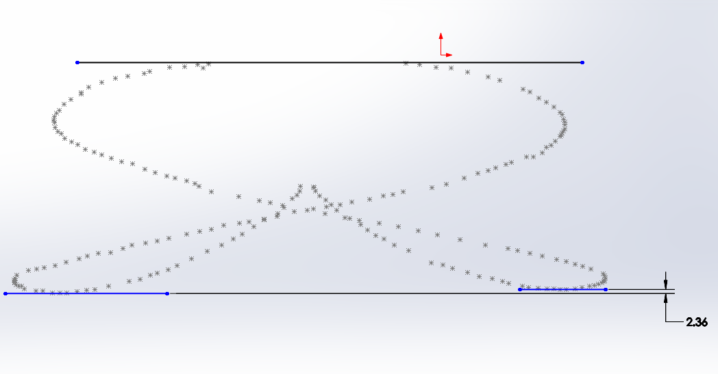
Blade-to-Blade Comparison – Cont’d
Blade height comparisons using boundary contours
1st Blade
Flow Direction
2nd Blade
Blade Height Comparisons
Methodology: Both blades were scanned for their boundary contour.
Observations: The trailing edge (or highest point when the prop is installed) of the 1st blade is 2.36mm higher than the 2nd blade. This further confirms that the scanned blade was shifted upward along the axial direction
12

Slide 13
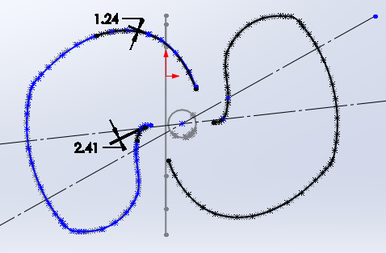
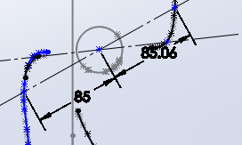
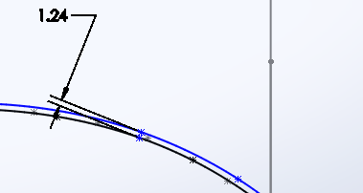
Blade-to-Blade Comparison – Cont’d
Further comparisons were made between these two blades
2nd Blade (Blue)
1st Blade (Black)
Near-hub contour shows symmetry
Boundary Contour Comparisons
Deviation near leading edge
Methodology: Both blades were scanned for their boundary contour. The contour of the 1st blade was then rotated 180 degrees to be compared with the 2nd blade
Observations: The 1st blade matches very well with the 2nd blade after the 180-degree rotation (see picture above). Only some small deviations were seen at the leading edge
13

Slide 14
Diagnosis of Reported Issue
At this point of the analysis, it seems like the vibration is likely to be caused by an uneven position of the two blades
The scanned blade has a nearly identical diameter and pitch when compared to the customer drawing. This indicates that the scanned blade conforms to the design
However, the scanned blade sits about 2 mm higher than the 2nd blade. The unbalanced hydraulic loads will create a force couple that causes potential vibration
While a statically balanced propeller may work well during dry run, the unbalanced loads will be magnified under wet conditions, hence creating hydraulic vibration
Excessive manual grinding that was seen on the blades may further cause unbalanced loading and disturbance to the flow pattern
In conclusion, GloTech believes that the geometrical inaccuracy and non-uniform mass distribution seen on the sample prop could be the major cause of the reported hydraulic vibration

Slide 15
Proposed Next Steps
The following steps are proposed to resolve the reported issue
GloTech to complete the 50HP prop design with the 2nd blade fully identical to the 1st blade in terms of axial position, orientation, thickness, etc.
Additional vane-smoothing techniques to be applied using GloTech’s proprietary impeller design methodology, to ensure optimal hydraulic performance and efficiency
GloTech to provide 2 (two) sample propellers using a combination of 3D printing / CNC machining techniques and precision casting, which will significantly reduce the prototyping lead time and cost
GloTech to cast, set the pitch, machine, and dynamically balance each prop prior to shipping. Customer will receive pre-pitched and fully dynamically balanced propellers, as opposed to “prop castings”
Customer to test and approve the prototype propellers using its standard testing facilities and protocols

Slide 16
Timeline
Preliminary project timeline Proposal
Week of
Project Phase | 4/19 | 4/26 | 5/3 | 5/10 | 5/17 | 5/24 | 5/31 | 6/7 | 6/14 | 6/21 | 6/28 | 7/5 | 7/12 | 7/19 | 7/26 | 8/2
Finalize Design
Production Tooling
Prototype Production
Prototype Testing / Design Review
PRELMINARY

Slide 18
Project Background
In 04.2021, a design proposal was presented to customer to address the hydraulic vibration issues
It was previously identified that the unbalanced blade geometry is the main cause of hydraulic vibration
In addition to correcting the blade geometry, GloTech has identified the following design optimization objectives:
Smooth out vane geometry, using a parametric, spanwise lofting technique
Reduce prop weight by thinning out on the back side of the propeller
Add keyway feature for additional mounting configuration
The goal is to optimize the propeller in order to eliminate vibration, while maintaining the same hydraulic / aeration performance.
18

Slide 19
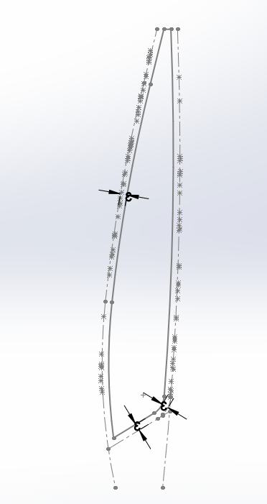
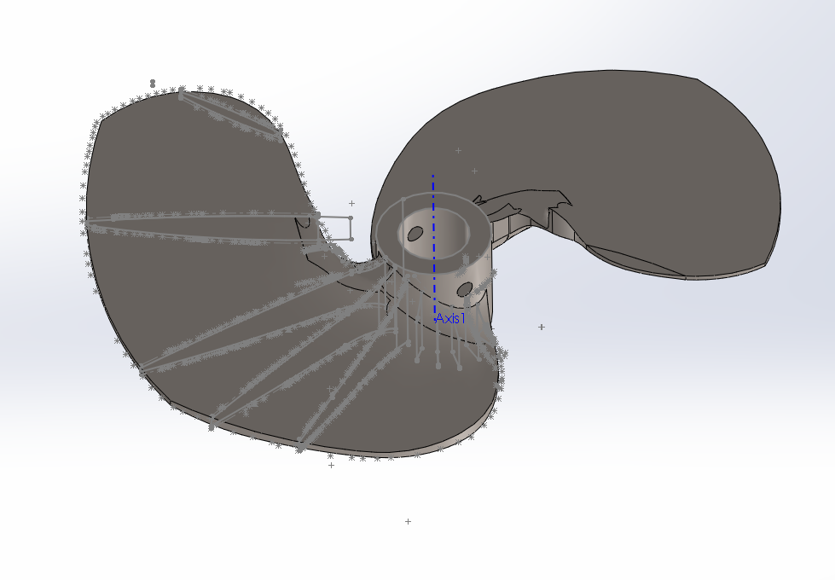
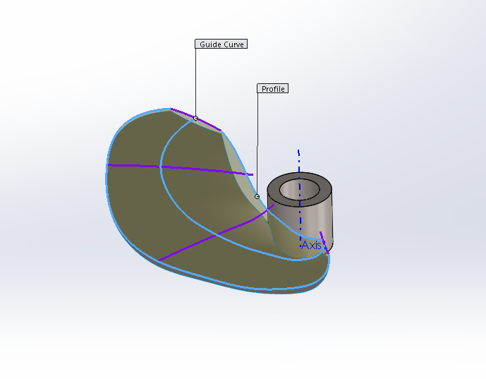
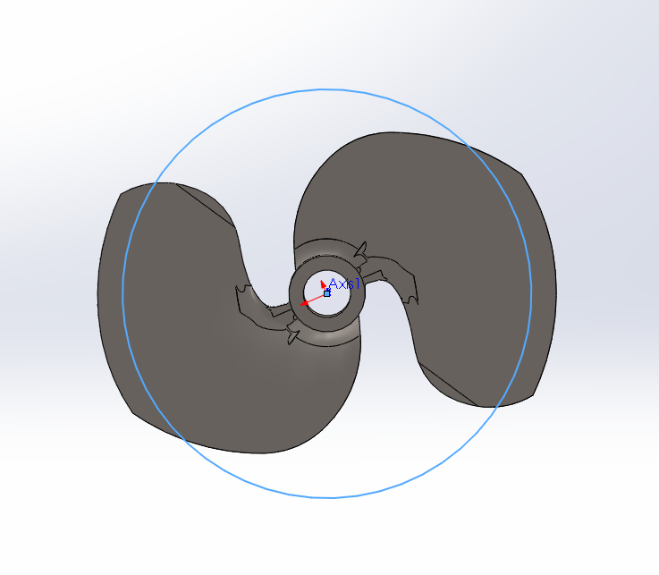
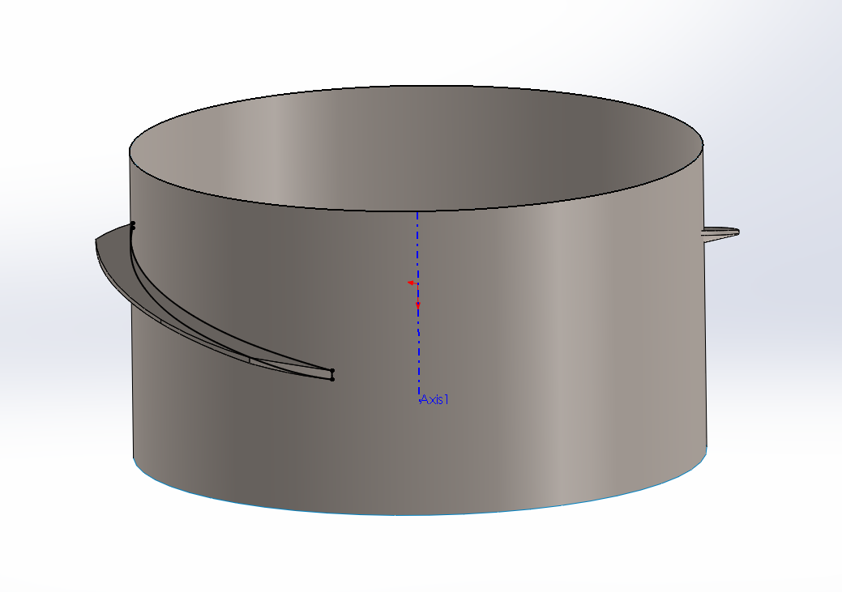
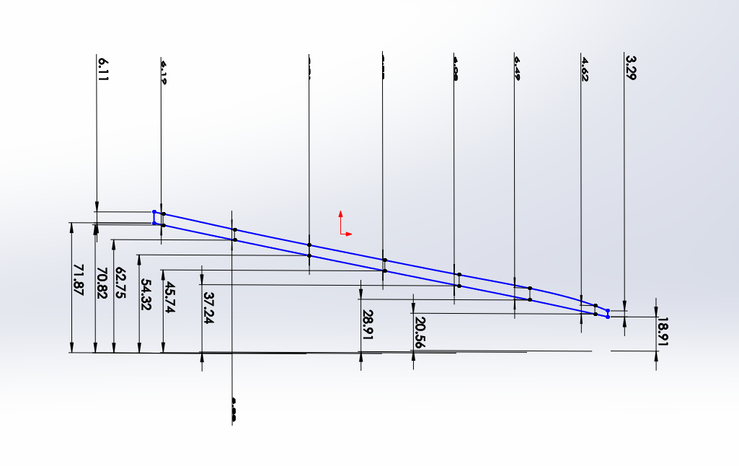
Methodology – Blade Remodeling
Using the scan from the 50HP, the propeller was modified as shown below.
Original Scan of 50HP Prop
Original scan
Profiles used for Guidelines
Loft (blue lines were created using a spline and connecting the guideline profiles)
Reconstructing Hydraulic Sketches from Blade Model
Create a cylindrical surface
Create an intersection curve & the solid body modeled from the scan
The side profile can then be furthered using 10deg intervalley placed planes
19
The goal is to create a set of hydraulic sketches in order to obtain a modifiable prop blade.

Slide 20
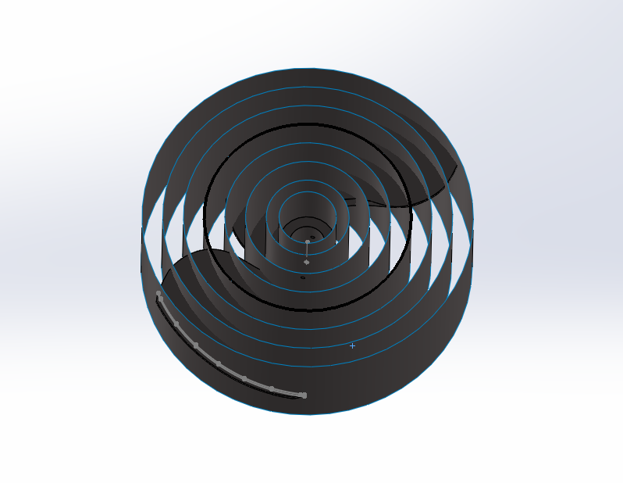
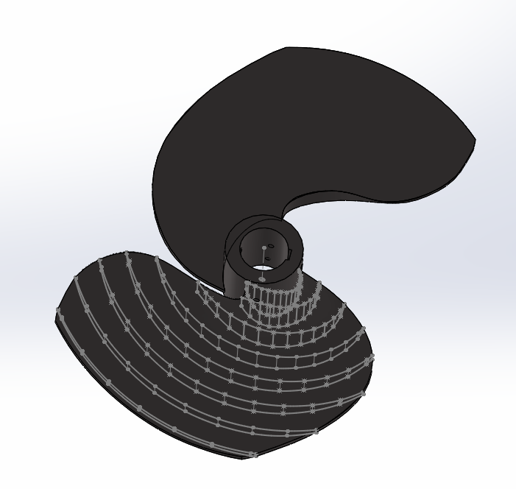
Methodology - Blade Remodeling
Using the scan from the 50HP, and the steps shown in the previous slide we can repeat this process for multiple cylindrical surfaces and sketches.
50HP Remolded Using 8 Hydraulic Sketches
This is a standard practice when it comes to propeller hydraulic / tooling design
20

Slide 21
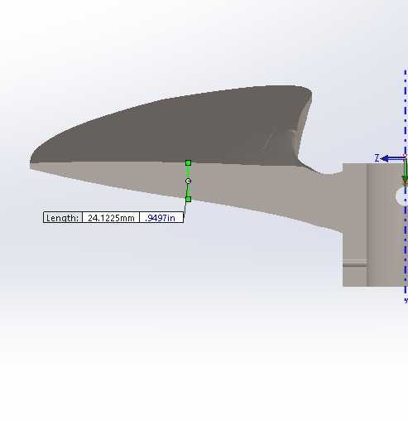
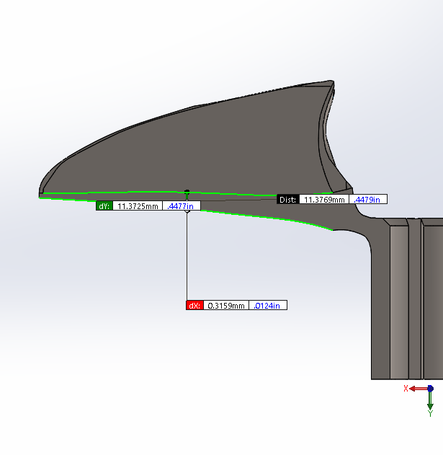
Methodology – Vane Thickness Reduction
A previous scan was done on the 75HP propeller, which will be used as a design benchmark for the vane thickness reduction
50HP Prop
75HP Prop
Thickness taken at 50% from the OD of 50HP prop is about 24 mm
Thickness taken at 50% from the OD of 75HP prop is about 11 mm
The goal is to thin out the geometry while maintaining the pitch desired. Hence the front (pressure) side of the prop geometry will remain unchanged
While the 75HP prop is more lightweight, customer had reported occasional blade damage due to insufficient thickness / strength
As such, excessive reduction in blade thickness should be avoided due to strength considerations
21

Slide 22
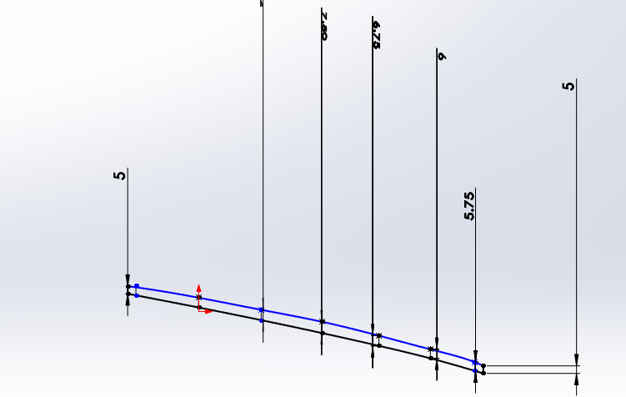
Methodology – Vane Thickness Reduction
Using the intersection curves we created, we now have the adjustability discussed. The first parameter changed was the edge thickness.
50HP @ OD
Before
After
After comparing the vane thickness between the two props, it was noticed that the original 50HP prop has an edge thickness varying from 3mm to 7mm +, whereas the 75HP prop has a uniform 3mm thickness.
Therefore, it was determined that a 5mm uniform thickness should be applied to the 50HP prop
22

Slide 23
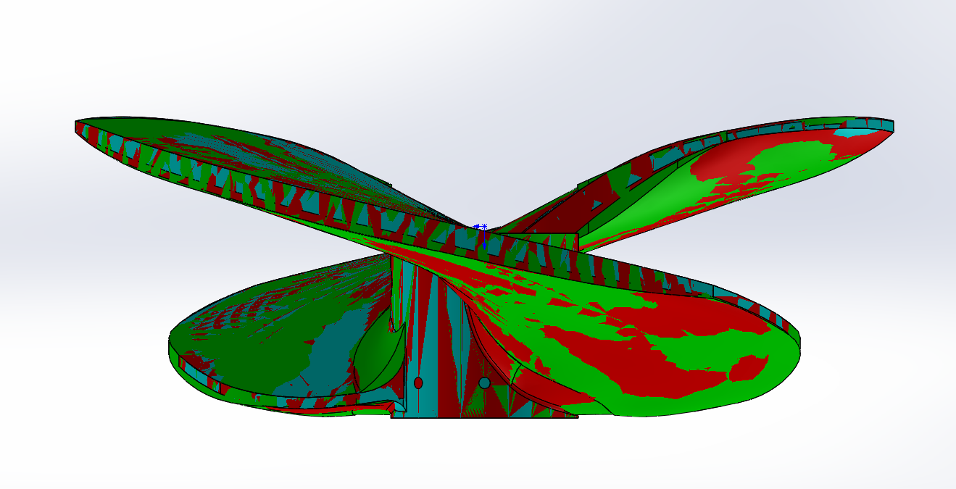
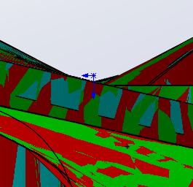
3-Prop Comparisons
Using a cylindrical cut at 420mm, the vane thickness change can be easily compared.
Green: Original blade
Red: Smoothed blade
Cyan: Thinned blade
The goal was to thin out the vane uniformly, while keeping the working surface the same. The thickness was reduced.
23

Slide 24
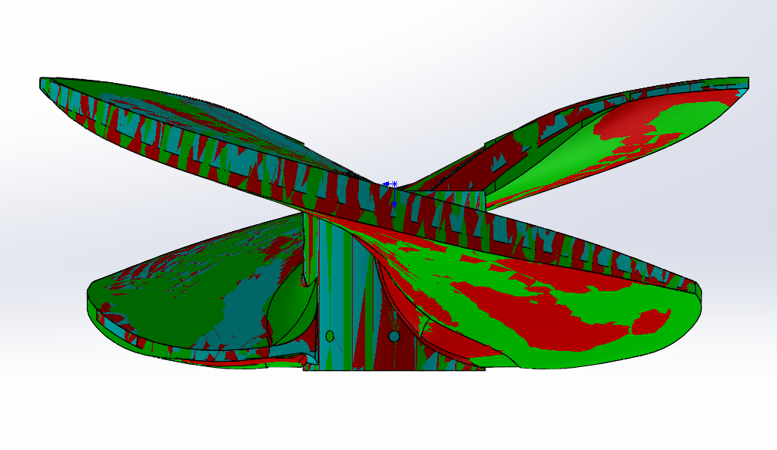
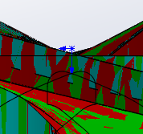
3-Prop Comparisons
Using a cylindrical cut at 360mm, the Vane thickness change can be easily compared.
Green: Original blade
Red: Smoothed blade
Cyan: Thinned blade
The goal was to thin out the vane uniformly, while keeping the working surface the same. The thickness was reduced.
24

Slide 25
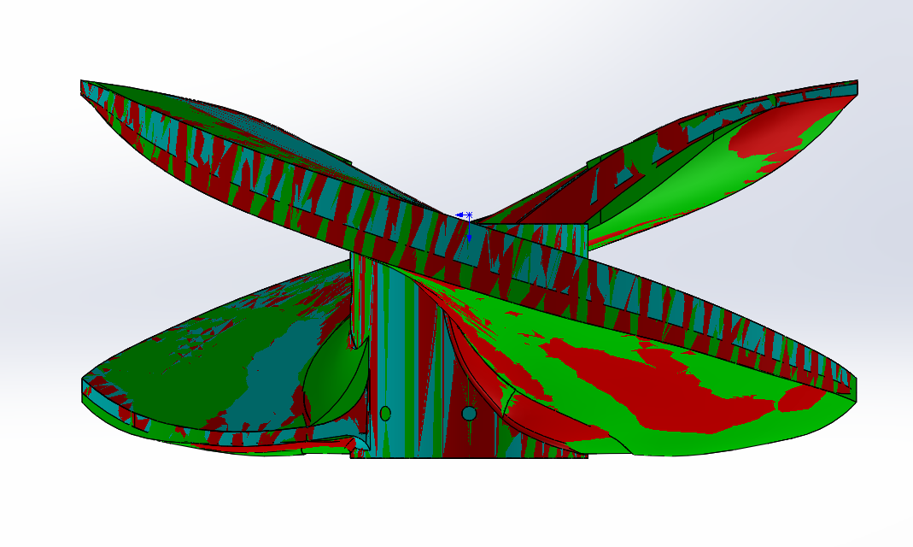
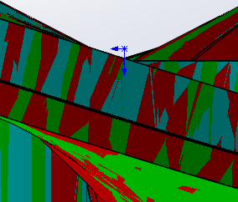
3-Prop Comparisons
Using a cylindrical cut at 300mm, the Vane thickness change can be easily compared.
Green: Original blade
Red: Smoothed blade
Cyan: Thinned blade
The goal was to thin out the vane uniformly, while keeping the working surface the same. The thickness was reduced.
25

Slide 26
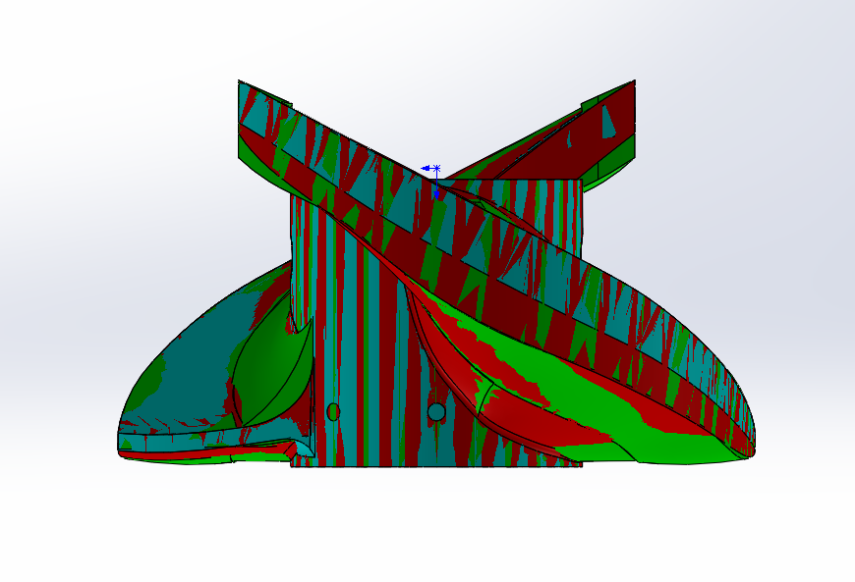
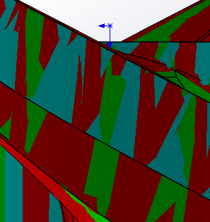
3-Prop Comparisons
Using a cylindrical cut at 180mm, the Vane thickness change can be easily compared.
Green: Original blade
Red: Smoothed blade
Cyan: Thinned blade
The goal was to thin out the vane uniformly, while keeping the working surface the same. The thickness was reduced.
26

Slide 27
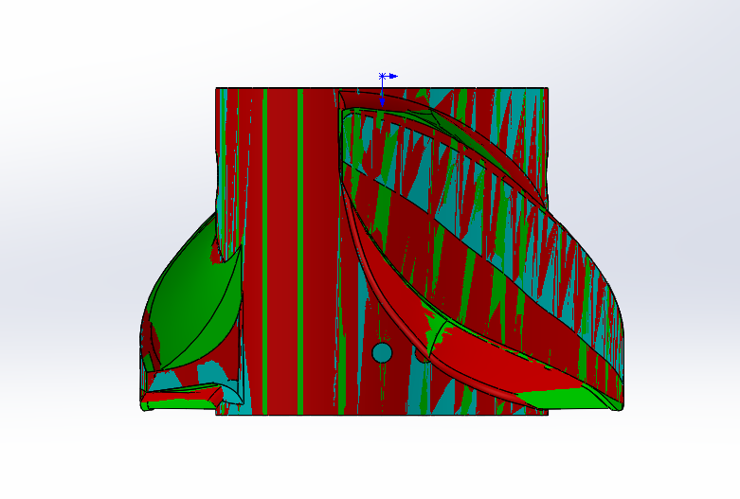
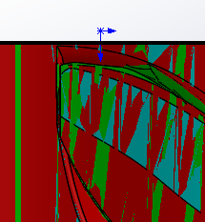
3-Prop Comparisons
Using a cylindrical cut at 120mm, the Vane thickness change can be easily compared.
Green: Original blade
Red: Smoothed blade
Cyan: Thinned blade
The goal was to thin out the vane uniformly, while keeping the working surface the same. The thickness was reduced.
27

Slide 28
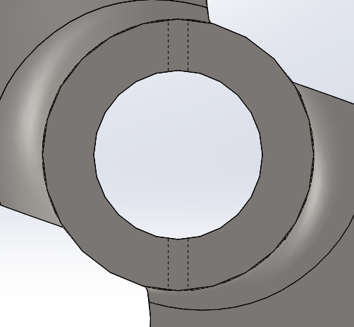
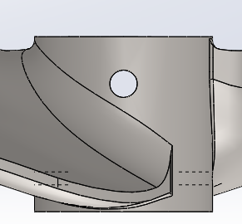
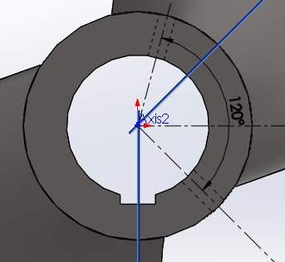
3-Prop Comparisons
Using the original mounting configurations additional improvements were added.
Set screw location before
Pin location remains
Set screw location after
The goal is to optimize each aspect of the 50HP prop.
The set screw set was changed from 180 deg apart to 120deg creating a more secure fit
A ½” key slot was added for additional mounting configurations
28

Slide 29
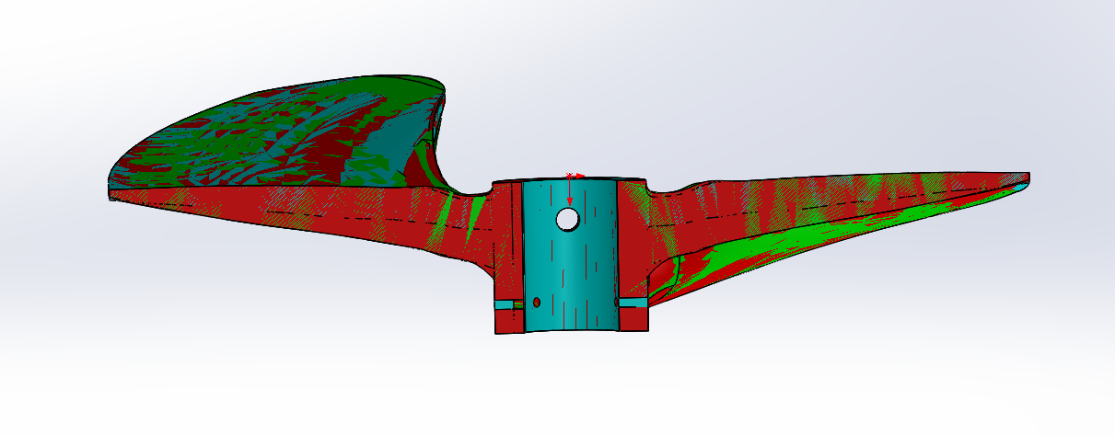
Conclusion
Working side of the Vane Geometry smoothed while maintaining a consistent pitch
Leading and trailing edges made more consistent while reducing overall thickness
Overall weight reduction from the original scan is 5.37kg, or 30.4%

Slide 31
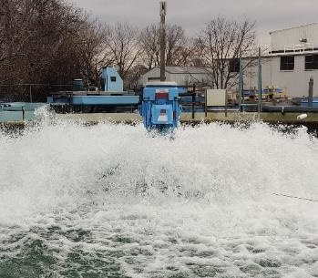
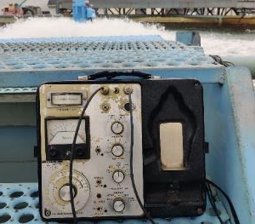
Background
In 02/2022, customer conducted wet testing on the prototype 50HP props provided by GloTech
On 02/16, GloTech joined customer in reviewing the sample QC and test results
Test pass/fail criteria as identified by customer:
Maximum vibration: 0.3 in/s
Power Drawn: 88-95% of nominal motor HP
Test results:
# | Description | Vibration (in/s) | Power Drawn
1 | Polished (001) – as-is | 0.250 | 81.7%
2 | Unpolished (002) – as-is | 0.275 | 76.2%
3 | Polished (001) – pitched* | 0.280 | 83.4%
* Polished sample was re-tested after pitch/rake adjustment
50HP Sample Prop Wet Testing and QC Inspections at AAS
Vibration measurements: 0.25 - 0.28 in/s -> Both samples passed the vibration test (<= 0.3 in/s)
Power (measured as % of amperage drawn): 76.2% - 83.4% -> Both are lower than the requirements (88-95%)
Potential causes: 1) uneven rake angle (test #3 suggests that rake adjustments contributed to a ~2% power increase); 2) blade thickness optimization may have inadvertently reduced the power consumption
31

Slide 32
CFD Design Study
We conducted a CFD study to better understand the wet test results and to develop necessary design updates to meet Customer’s targets
CFD Workflow
3D modeling of 50HP surface aerator
System curve estimation
CFD (Computational Fluids Dynamics) setup overview
CFD results – effect of flat rake
Proposed design updates
CFD results – updated propeller
Spray pattern simulations and CFD results
32

Slide 33
50HP Aerator Modeling
First, a simplified 3D model of the 50HP aerator is created to provide geometries and dimensions needed for subsequent simulations
50HP Motor
50-75HP Diffusion Head
Atmosphere
Float (Not Shown)
Column Pipe
50HP Propeller
Suction Tube
50HP Surface Aerator Assembly
33

Slide 34
System Curve Estimation
Based on our assumptions, the system curve of the 50HP aerator is plotted out in order to locate its operating point
Diffusion Head
(k=1.41*)
Lift = 1.08’
Column
(k=0.02)
Operating Water Level
Suction
(k=0.71)
Estimated System Curve of a 50HP Surface Aerator
Flow (GPM) | Friction (ft) | Lift (ft) | System H (ft)
9000 | 3.00 | 1.08 | 4.08
11000 | 4.48 | 1.08 | 5.56
13000 | 6.26 | 1.08 | 7.34
15000 | 8.33 | 1.08 | 9.41
17000 | 10.70 | 1.08 | 11.78
K_total = K_suct.+ K_col . + K_disch.= 2.14
* Due to its unique geometry, the K factor of the discharge cone was estimated using CFD head-loss simulation
34

Slide 35
CFD Setup Overview
The initial CFD study focuses on simulations of head (pressure) and power of the aerator using a single-phase, steady state setup
Volume Extraction
Meshing
Boundary Conditions
Outlet BC: Atmosphere
Discharge
Prop
Suction
Inlet BC: Mass Flow
SpaceClaim
Ansys Meshing
CFX-Pre
2D up / 4D down
Stationary suction and discharge
Rotating propeller with counter-rotating shroud
Tetrahedral, 20mm max.
5 layers, 1.2 growth rate
0.77 Transition ratio
Mesh count: 1.2 million +
Mass flow in + pressure out
Frozen rotor
SST (Shear Stress Transport)
Free-slip wall in & out
No-slip wall elsewhere
35

Slide 36
CFD Results – Effect of Flat Rake
First we simulated the results of our initial sample prop design, and the effect of “pitching” it to provide a constant, flat rake
CFD Results – Current Design (Sample As-built)
Flow (GPM) | Head (ft) | Power (HP) | Efficiency
9000 | 13.80 | 64.73 | 48.4%
11000 | 11.43 | 54.83 | 57.9%
13000 | 8.60 | 43.44 | 65.0%
15000 | 5.49 | 31.07 | 67.0%
17000 | 2.09 | 17.21 | 52.0%
CFD Results – Current Design w/ Flat Rake Adjustments
Flow (GPM) | Head (ft) | Power (HP) | Efficiency
9000 | 13.98 | 65.15 | 48.8%
11000 | 11.86 | 56.36 | 58.4%
13000 | 9.22 | 45.71 | 66.2%
15000 | 6.18 | 33.68 | 69.5%
17000 | 2.77 | 19.85 | 60.0%
Note: generally speaking, the physical testing results are expected to be somewhat lower than the CFD simulations, which reflect performance in simplified / ideal vs. real-world conditions
CFD suggests that the flat rake adjustments appears to increase the overall output of the propeller. The head, power and efficiency all increased across multiple flow rates
36

Slide 37
CFD Results – Effect of Flat Rake
Further analysis of our CFD results showed that the simulation closely reflected actual wet-testing data.
CFD estimated duty point:
Current design w/o rake adjustments: 13,500 GPM @ 7.8 feet
Current design w/ rake adjustments: 13,750 GPM @ 8.1 feet
Takeaways:
The flat-rake design appears to improve both flow and head, which is expected to provide better aeration efficiency
CFD estimated power drawn:
Current design w/o rake adjustments : 40.35 HP -> 80.7% HP drawn
Current design w/ rake adjustments: 41.2 HP -> 82.4% HP drawn
Takeaways:
Simulation results CLOSELY matches testing results (81%-83% power)
This indicates that our simulation model can be accurately used to validate prop design updates
The intersection of the system curve and head curve determines the operating point
37

Slide 38
Proposed Design Updates
After additional design iterations and CFD verifications, GloTech proposes TWO updates to our 50HP prop design
1
Propeller Blade Surface with Constant / Flat Rake
“Construction lines” to ensure a flat rake angle across the working surface
2
Propeller Blade Thickness Increase
Blade is thickened (especially at hub area) for increased strength, per Customer’s request
Current
Current
Optimized
Optimized
38

Slide 39
CFD Results – Updated Propeller
Our simulations suggest that the proposed design updates will meet/ exceed customer’s performance requirements
CFD estimated duty point :
Current: 13,500 GPM @ 7.8 feet
Updated: 14,410 GPM @ 8.8 feet
CFD estimated power drawn:
Current: 40.35 HP -> 80.7% HP drawn
Updated : 45.98 HP -> 91.9% HP drawn
Flow (GPM) | Head(ft) | Power(HP) | Efficiency
9000 | 15.26 | 69.90 | 49.6%
11000 | 13.57 | 63.41 | 59.4%
13000 | 10.82 | 53.29 | 66.6%
15000 | 8.00 | 42.93 | 70.6%
17000 | 4.87 | 30.97 | 67.5%
Main takeaways:
The proposed design is expected to improve the flow by ~6% and head by ~9%
In the meantime, the power drawn is expected to increase by 14%, which puts it at ~91.9% of the nominal motor HP
39

Slide 40
Spray Pattern Simulations
We further developed a transient, multi-phase CFD simulation to visualize the spray patterns of the two prop designs
CFD Setup
Air/Water Multi-Phase Domain
Outlet: Atmosphere
Water Domain
VOF (Volume of Fluid) method
2D, transient study
Boundary conditions:
Velocity in
Atmosphere out
Inlet: Flow Velocity
40

Slide 41
CFD Results – Spray Pattern
Head-to-head CFD results to show the spray pattern (throw radius) of the current prop design and the updated design
Current Design
CFD estimated spray radius:
Current: 7.3 feet
Updated: 7.8 feet
~7% (0.5 ft) increase
CFD estimated flow rate:
Current: 13,500 GPM
Updated: 14,300 GPM
~6% increase
Conclusions
The results of this simulation is preliminary given the assumptions we’ve had to build in due to our limited exposure to the product application
However, we are confident of a relative increase both in the spray radius and flow rate, which should lead to more oxygen transfer and aeration efficiency
~0.5 ft
Initial State
Intermediate State
Steady State
Updated Design
Initial State
Intermediate State
Steady State
41

Slide 42
Redesign Conclusions
Summary and technical proposal:
As was observed during testing, GloTech’s initial 50HP props produced a lower power drawn (76% – 82%) than the design target of 88% - 95%
GloTech built a CFD simulation model that was able to mirror the observed prop performance, as well as the impact of adjusting the propeller rake to be constantly flat
Via iterative design updates / simulations, we have completed an updated prop design with two main changes:
A constant, flat rake blade surface that is similar to the existing product
Increased blade thickness to further improve mechanical strength and to prevent premature failure
Our CFD simulations of the updated design suggest that the prop will completely meet customer’s product requirements in terms of performance (power draw) and strength, while potentially improving aeration efficiency
42

Slide 43
Appendix – CFD Velocity Maps
Current Design (As-Built)
Optimized Design
43

Slide 44
Appendix – CFD Pressure Maps
Current Design (As-Built)
Optimized Design
44

Slide 45
Appendix – Future Design Alternative
Alternative design option for future considerations: 5% trailing edge extension + slightly thickened blade + flat rake
Dashed line: Before adjustment
Solid line:
After adjustment
Future Design Alternative – Trailing Edge Extension (~5%) + Small Increase in Blade Thickness
A small increase in blade working area can improve the performance including flow, head and power
CFD predicts ~ 90% of power drawn; 14,200 GPM @ 8.67 feet
45

Slide 46
Final Testing Results
Glow Tech Prop exceeds the customer’s design targets!

Slide 47
Final Project Conclusions
All Customer design objectives met or exceeded.
Customer reported Excessive vibration during aerator operation on existing 50HP prop
Redesigned prop eliminated vibration effect!
Customer requested Improved product Quality.
Redesigned prop used improved casting methods removing all quality and uniformity issues.
Customer requested reduction of excessive labor due to pre-pitch balancing.
Better manufacturing method and improved design eliminated operation!
Customer requested their logo/cast letters to be added
Logo & casting Letters Added!
We were able to offer a lower cost too!
Customer Purchases redesigned Propeller & started additional projects to improve other propeller sizes!
47

