Slide 1
Market Overview: Pumps
GloTech Corporation

Slide 2
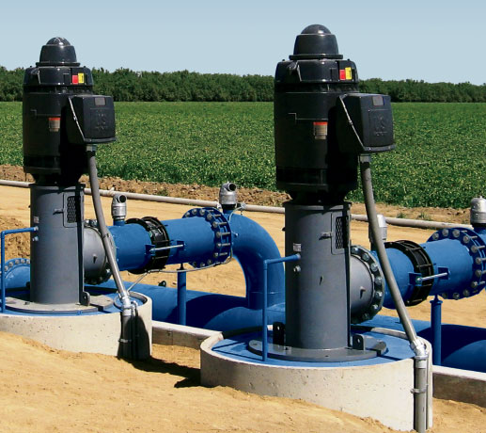
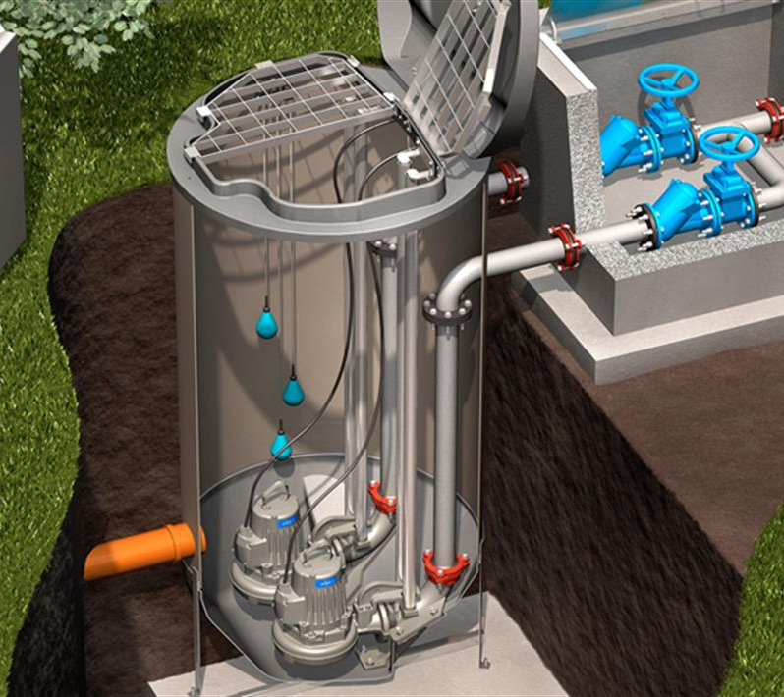
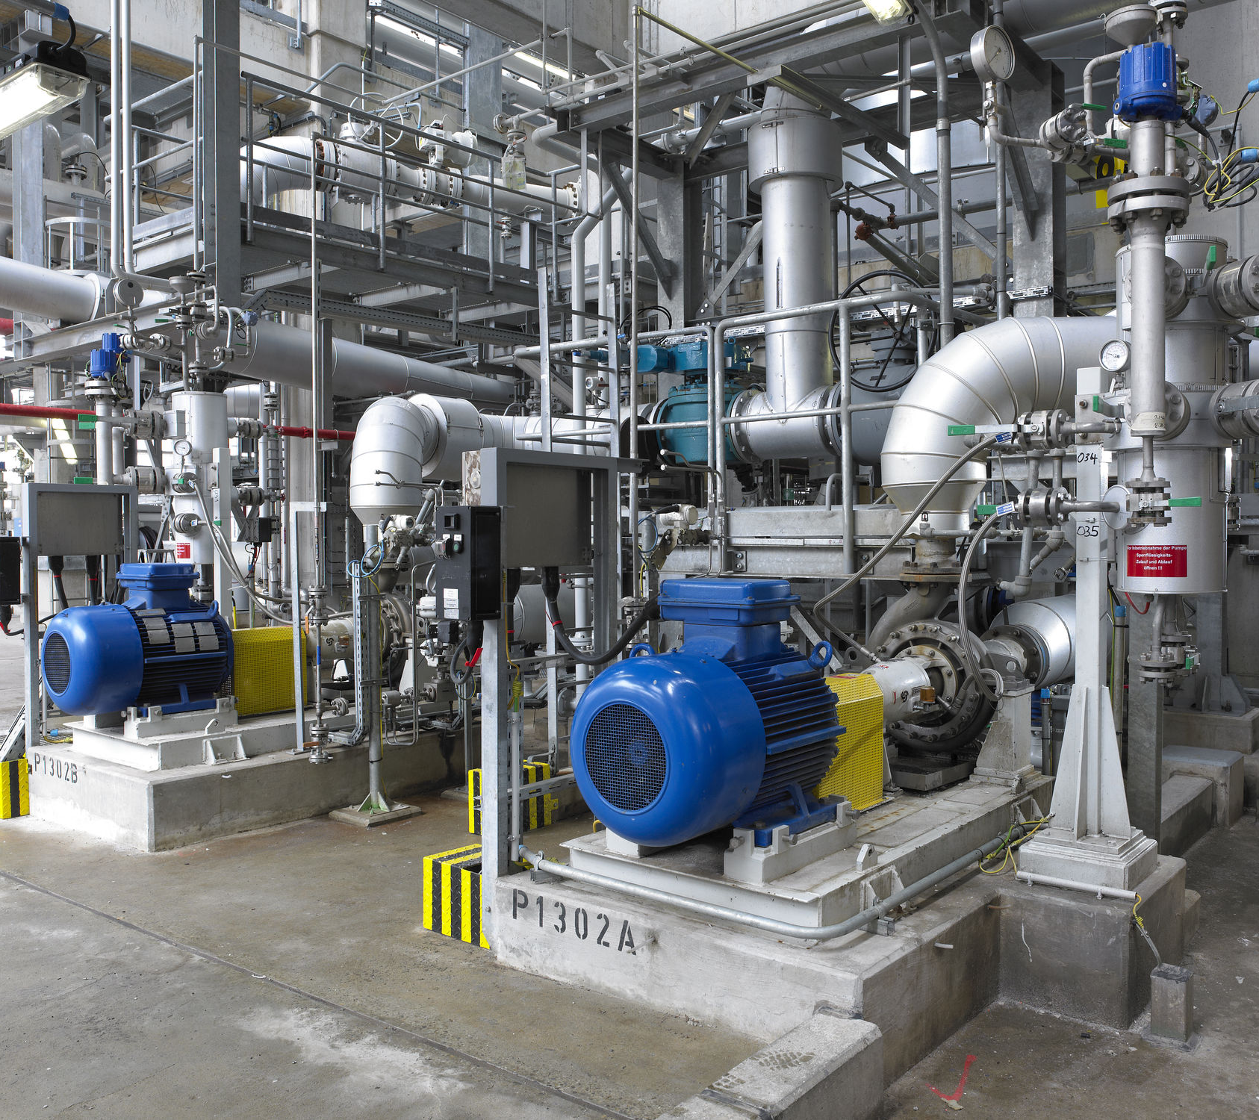
Background
Pumps used for lifting/transferring water are seldomly thought of, yet play an important role in many aspects of modern life
Pumps are everywhere: it is commonly estimated that ~10% of all the power generated worldwide is used to drive pumps
In everyday life, pumps are used to supply water to homes and buildings, move and treat sewage, irrigate landscaping, etc.
In some industrial sectors, pumps operation can often be the primary source of energy consumption and operating costs (chemical processing, oil & gas, etc.)
Selection of Water Pump Applications
Agricultural - Irrigation
Municipal - Sewage
Industrial - Chemical Process
Commercial - Water Park
2
Notes:
19% of all generated power in CA is used for water (transfer, distribution, irrigation, household, etc.) http://ww2.kqed.org/climatewatch/2012/06/10/19-percent-californias-great-water-power-wake-up-call/
22% of global energy consumed by motors is by pumps https://ieeexplore.ieee.org/stamp/stamp.jsp?arnumber=6408587
In the USA, 2% of all electricity used for water/wastewater, 1.2% for water supply, and 2.6% irrigation pumping. https://www.osti.gov/servlets/purl/1182984
Pumps account for 10% of world energy consumption https://blogs.sw.siemens.com/simcenter/poorly-designed-pumps-use-10-of-world-energy/
Electric motors use 45% of world’s energy https://cleantechnica.com/2011/06/16/electric-motors-consume-45-of-global-electricity-europe-responding-electric-motor-efficiency-infographic/#:~:text=Electric%20motors%20are%20the%20single,Energy%20Agency%20(linked%20above).
In the US industrial section, pump power usage is even higher https://www.energy.gov/sites/prod/files/G_Overview_of_Pump_Systems_Matter.pdf
24% of upstream oil production costs is frac pumps alone https://www.eia.gov/analysis/studies/drilling/pdf/upstream.pdf

Slide 3
History
Pumps have a long history, but have seen little recent innovation
3
Notes:
19% of all generated power in CA is used for water (transfer, distribution, irrigation, household, etc.) http://ww2.kqed.org/climatewatch/2012/06/10/19-percent-californias-great-water-power-wake-up-call/
22% of global energy consumed by motors is by pumps https://ieeexplore.ieee.org/stamp/stamp.jsp?arnumber=6408587
In the USA, 2% of all electricity used for water/wastewater, 1.2% for water supply, and 2.6% irrigation pumping. https://www.osti.gov/servlets/purl/1182984
Pumps account for 10% of world energy consumption https://blogs.sw.siemens.com/simcenter/poorly-designed-pumps-use-10-of-world-energy/
Electric motors use 45% of world’s energy https://cleantechnica.com/2011/06/16/electric-motors-consume-45-of-global-electricity-europe-responding-electric-motor-efficiency-infographic/#:~:text=Electric%20motors%20are%20the%20single,Energy%20Agency%20(linked%20above).
In the US industrial section, pump power usage is even higher https://www.energy.gov/sites/prod/files/G_Overview_of_Pump_Systems_Matter.pdf
24% of upstream oil production costs is frac pumps alone https://www.eia.gov/analysis/studies/drilling/pdf/upstream.pdf

Slide 4
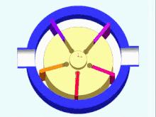
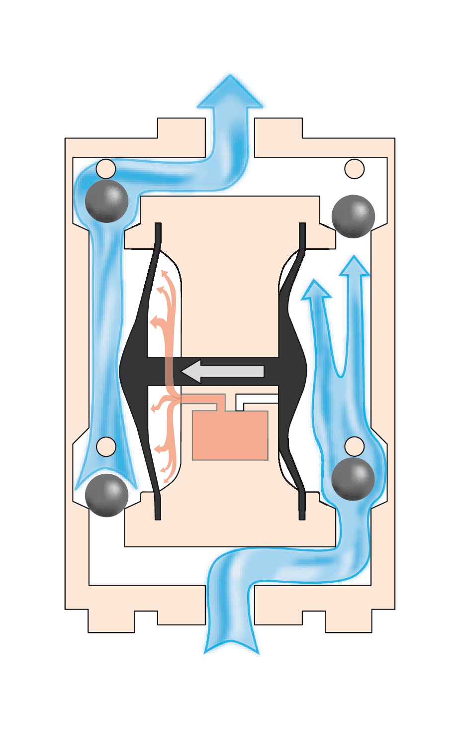
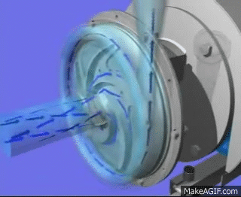
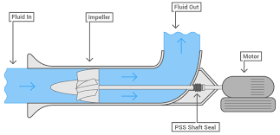
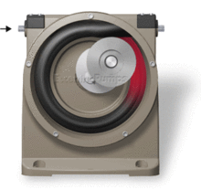
Pump Classification
GloTech has experience across the entire spectrum of pumps, but our current focus is on rotodynamic types
Pumps
Current GloTech Focus
Positive Displacement
Centrifugal
Axial Flow
Moves fluid by trapping a fixed amount in an expanding cavity (suction), and then forcing/displacing it out in a decreasing cavity (discharge)
Select types: rotary lobe, rotary gear, diaphragm, screw, vane, peristaltic, progressive cavity
Moves fluid which enters (suction) along a rotating axis (shaft), by accelerating it radially outward with an impeller into a diffuser or volute (discharge)
Many different centrifugal pump designs exist: horizontal / vertical, single / multi-stage, etc.
Moves fluid which enters (suction) along a rotating axis (shaft), by accelerating it in the same direction (axially) with a propeller into a diffuser (discharge)
Typically for moving large volumes at relatively low pressures. Mixed flows pumps can be placed in this category
4

Slide 5
Axial & Mixed Flow
GloTech has 20 years of experience designing axial and mixed flow pumps
Product Description
GloTech LAF/LMF series are line shaft axial and mixed flow pumps designed for moving very high volumes of water at relatively low heads. The LAF and LMF series offer advanced hydraulic designs with industry leading efficiencies. GloTech provides the most versatile line of axial/mixed pumps on the market, with the broadest hydraulic coverage, and a range of design and material options. This makes the LAF/LMF series the optimal solution for a wide range of applications including raw water intake, drainage/flood control, irrigation, and more.
Summary Specifications
Max Flow | 20 m³/s | 300,000 gpm
Max Head | 30 m | 100 ft
Speed | 300 - 1800 rpm
Efficiency | 77.5% - 90.1%
Power | 7.5- 1800 kW | 10 - 2400 hp
Applications
Stormwater / flood control Irrigation / drainage pumping stations Cooling / process water pumping Water parks
5

Slide 6
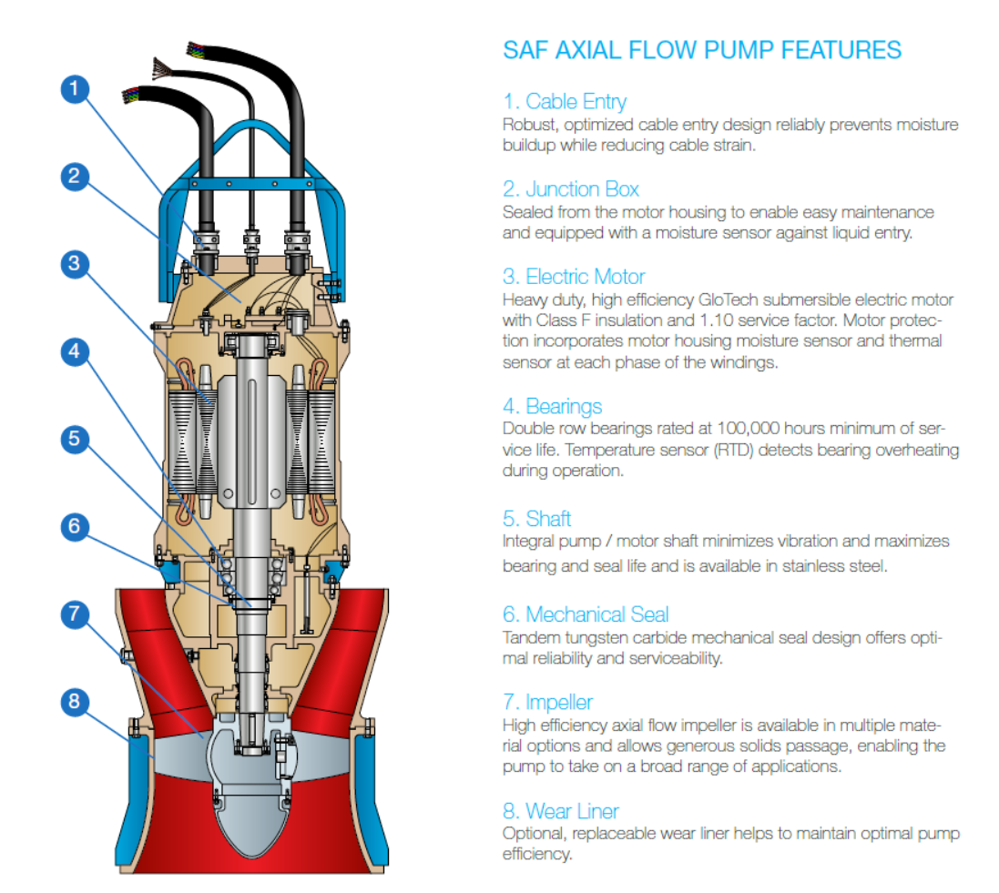
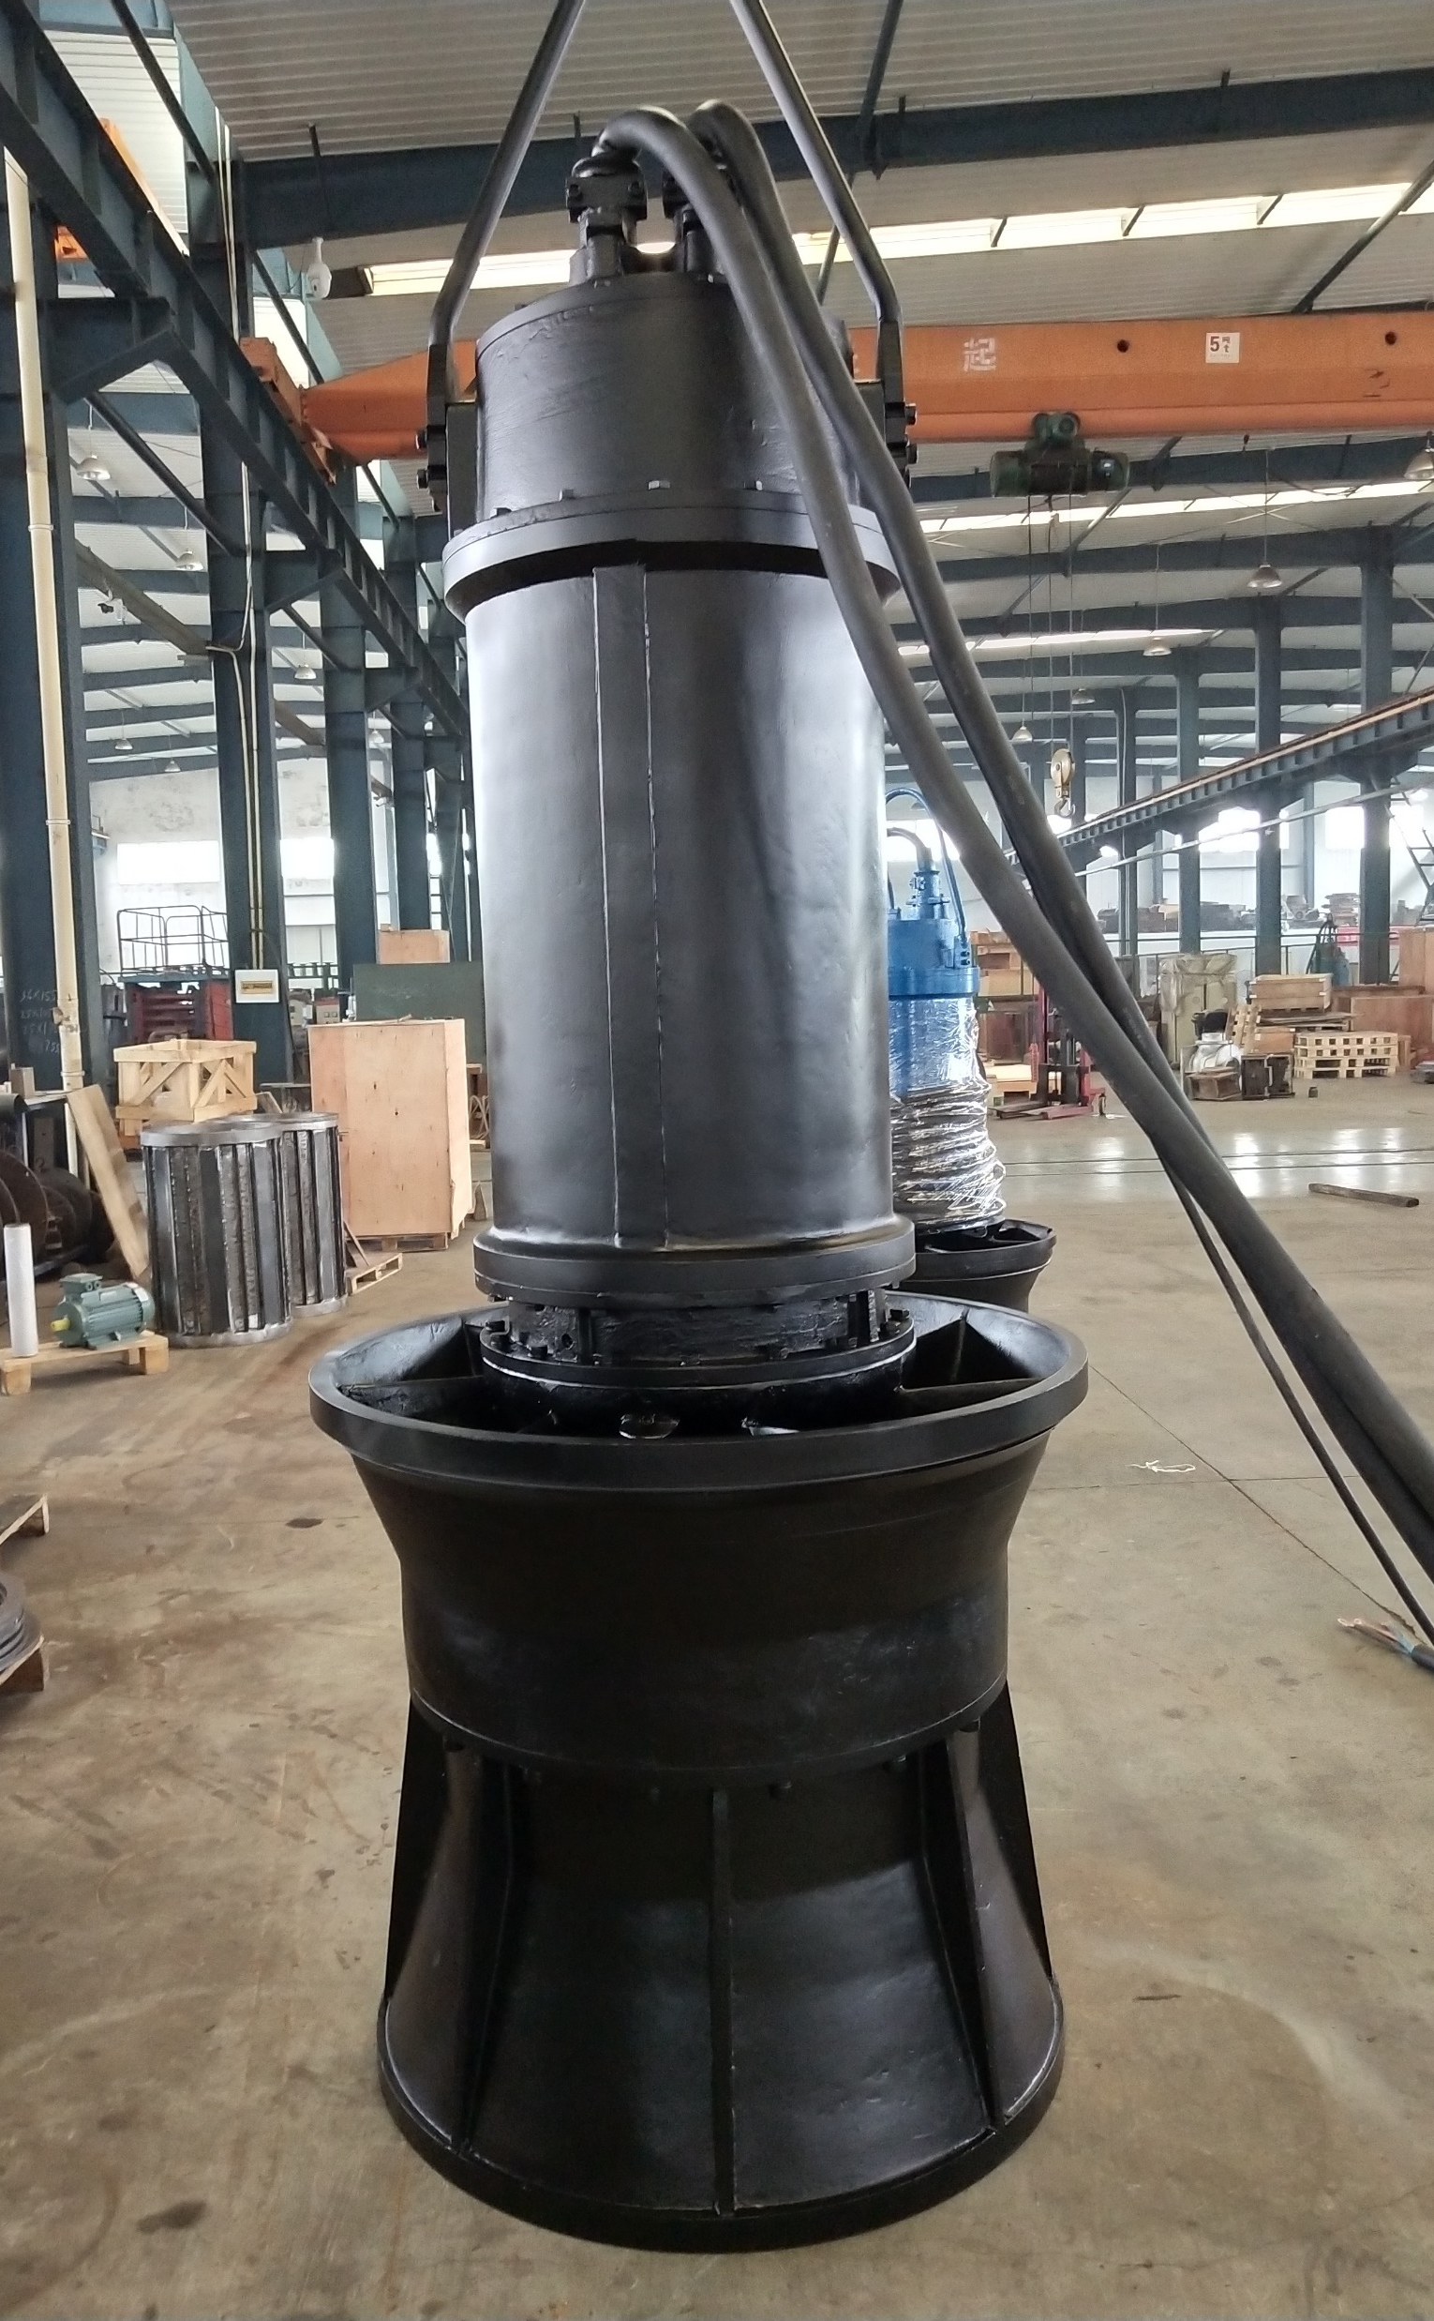
Axial & Mixed Flow
GloTech’s axial and mixed flow pumps are also available as submersibles (SAF / SMF series)
6

Slide 7
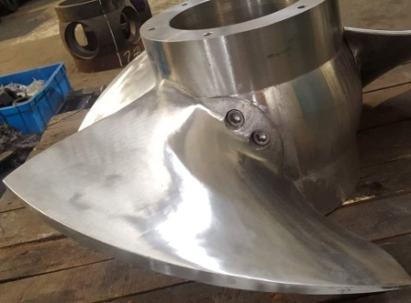
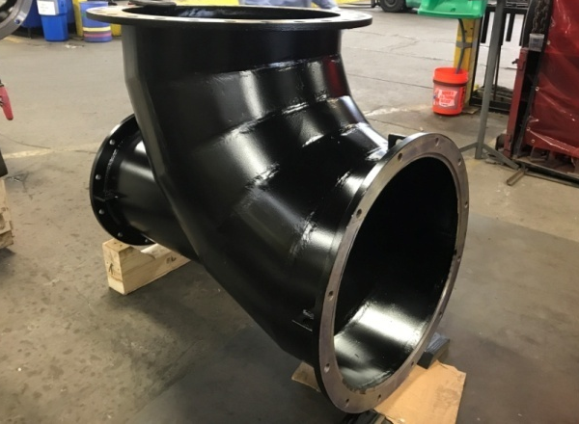
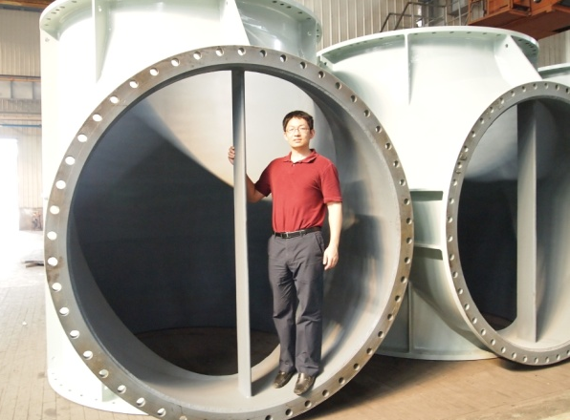
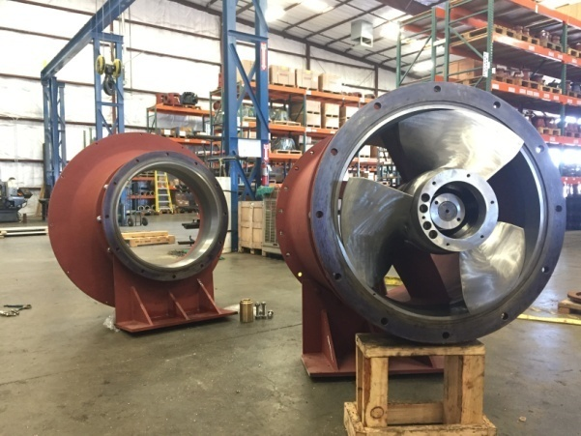
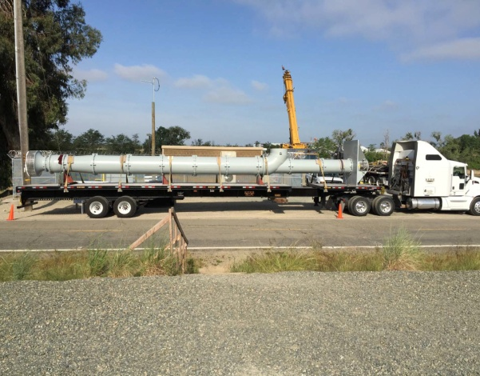
Axial & Mixed Flow
Photos of past GloTech engineered axial / mixed flow pump projects:
20” axial flow pump head
Adjustable pitch impeller design
Fabricated discharge elbow
Custom fabrication for engineered project
36” axial flow pump head
24” full pump assembly
7

Slide 8
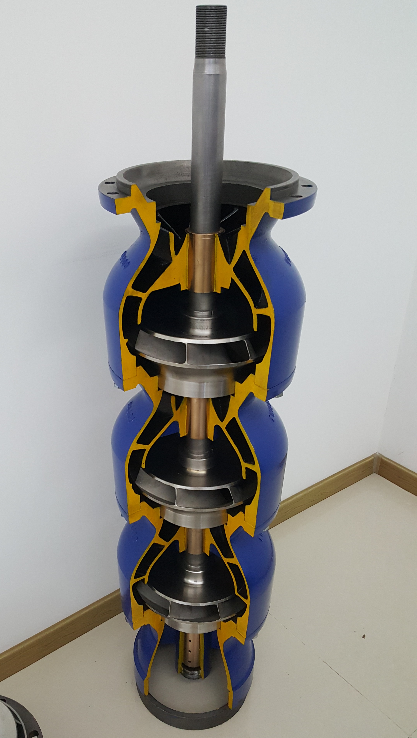
Axial - Vertical Turbine
Vertical turbines are ideal for high Head applications
Product Description
GloTech’s as developed key partners for our vertical turbine pumps which offer versatile solutions for a broad range of applications which require relative high heads. These pumps are designed to provide industry-leading efficiency and ease of maintenance. A wide range of material options are available for industry specific application requirements (e.g. wear/ corrosion resistance). Custom, larger volume pumps are also available.
Summary Specifications
Discharge | 100 - 600 mm | 4 - 24 in
Max Flow | 4,000 m³/h | 17,500 gpm
Max Head | 250 m | 800 ft
Efficiency | 62.0% - 86.0%
Power | 3 - 1000 kW | 5 – 1350 hp
Applications
Dewatering
Flood control
Industrial water circulation
Irrigation
Mining
Municipal water supply
Power generation
Water booster
8

Slide 9
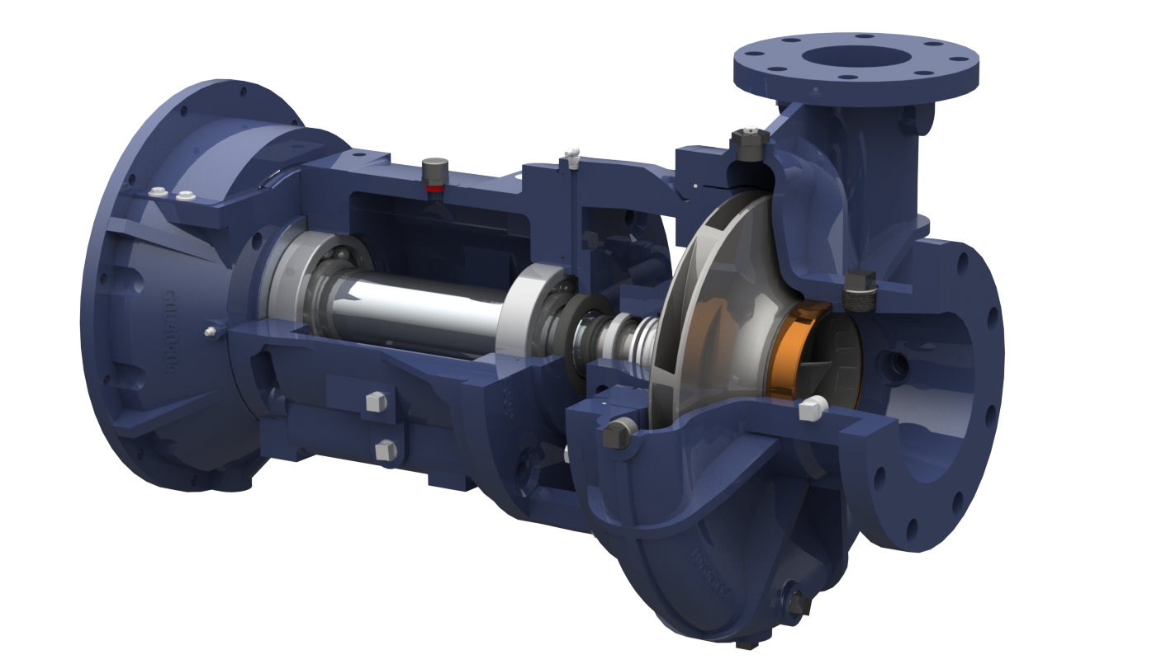
End Suction
Since 2018, GloTech has developed and launched a number of exciting new end suction centrifugal pump models
Product Description
GloTech offers several series of market-leading end suction centrifugal pumps for use in a wide variety of municipal and industrial applications. These pumps offer heavy duty construction and are designed to provide high efficiency and easy maintenance. The pumps are offered in horizontal or vertical, close coupled, frame-mounted or engine driven configurations.
Summary Specifications
Discharge | 50 - 300 mm | 2 - 12 in
Max Flow | 1,300 m³/h | 6,000 gpm
Max Head | 180 m | 600 ft
Efficiency | 67.0% - 89.0%
Power | 1.5 - 750 kW | 2 – 1,000 hp
Applications
Agricultural irrigation
Landscape irrigation
HVAC circulation
Industrial water circulation
Industrial process
Mining
Water booster
9

Slide 10
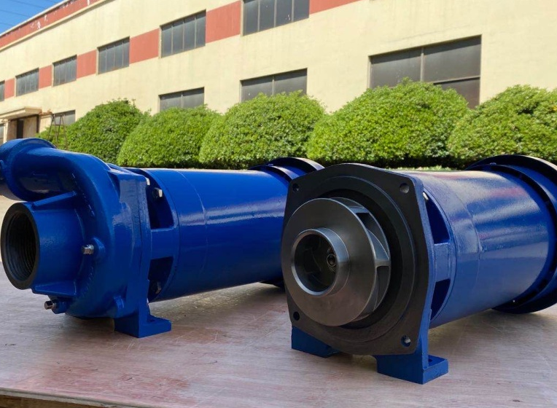
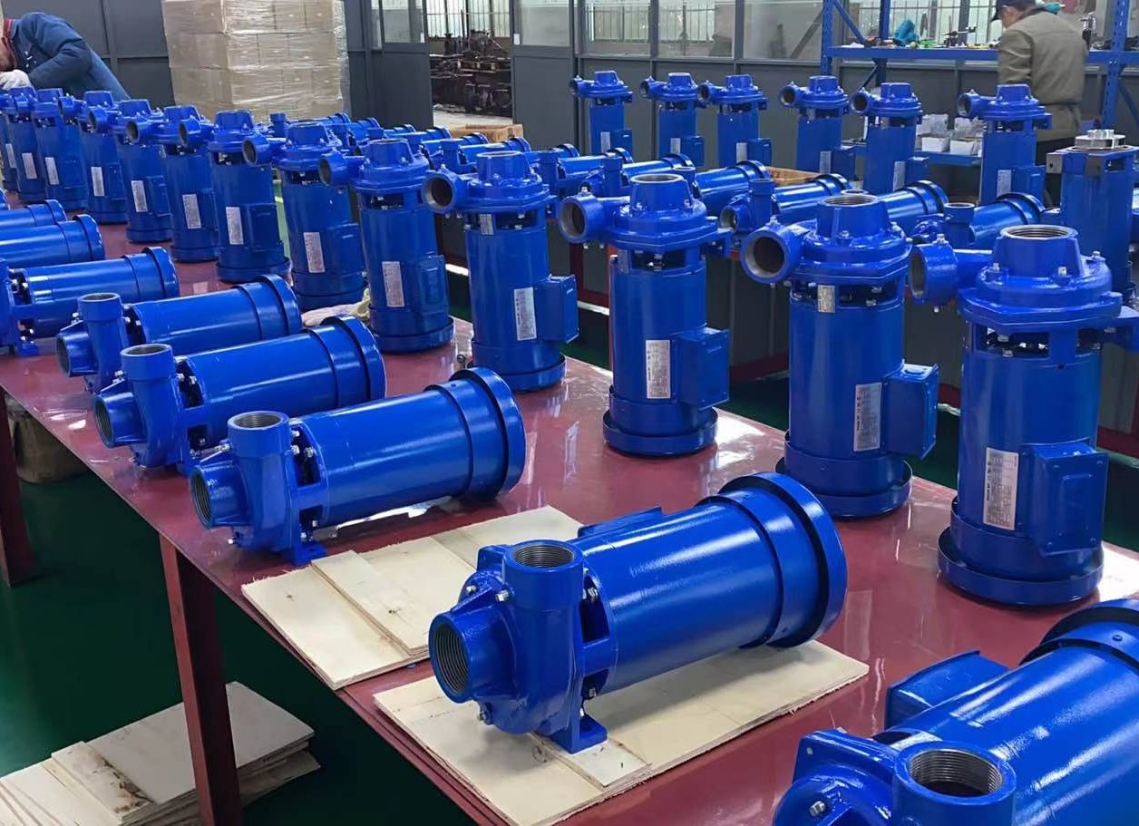
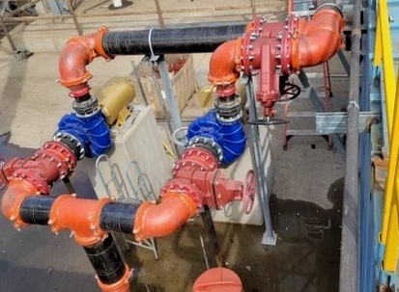
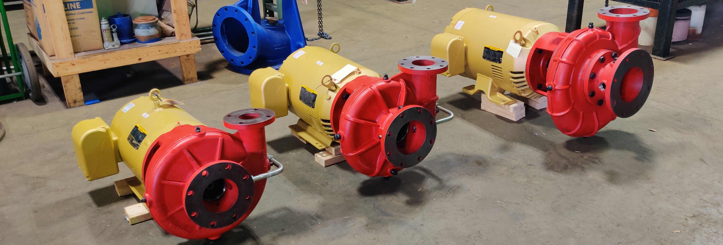
End Suction Centrifugal
Photos of past centrifugal pump lines
P2303 End Gun Booster
P2303 Product Assembly
P2303 Installation
P2100 Installation
P2100 Series Prototypes
10

Slide 11
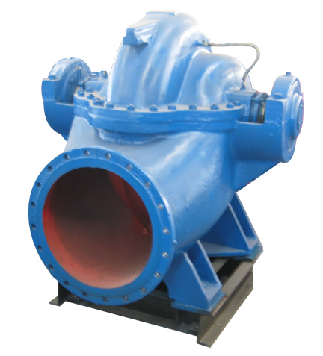
Split Case
Split case pumps are an emerging area of opportunity for GloTech
Product Description
GloTech’s HS series of single or double suction split case centrifugal pumps are designed to pump clear or low viscosity liquids at moderate heads up to high volumes. These rugged, heavy-duty pumps are easy to maintain and can be used for a broad range of municipal and industrial applications.
Summary Specifications
Discharge | 75 - 1000 mm | 3 - 40 in
Max Flow | 20,000 m³/h | 88,000 gpm
Max Head | 190 m | 620 ft
Efficiency | 63.0% - 92.0%
Max Operating Pressure | 2.5 MPa | 363 psi
Max Temperature | 105°C | 220°F
Applications
Water supply
Irrigation and drainage
Power generation
Industrial water circulation
Fire fighting
HVAC
Marine service
Seawater desalination
11

Slide 12
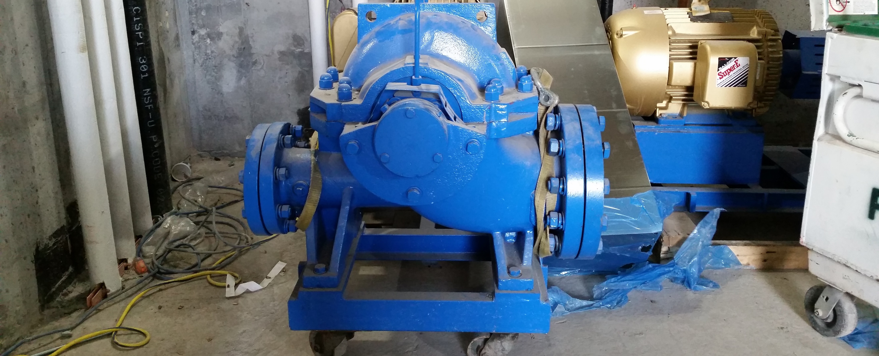
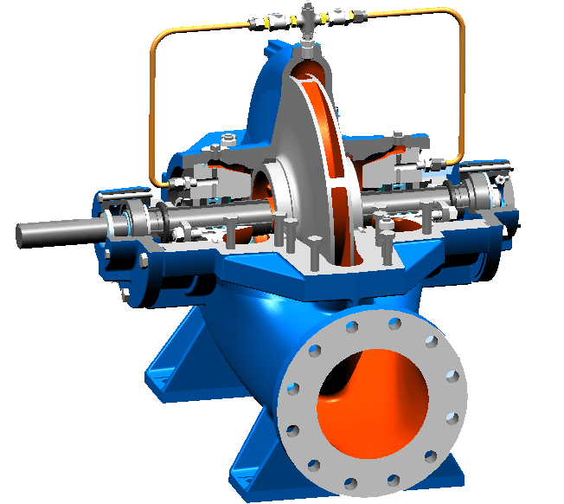
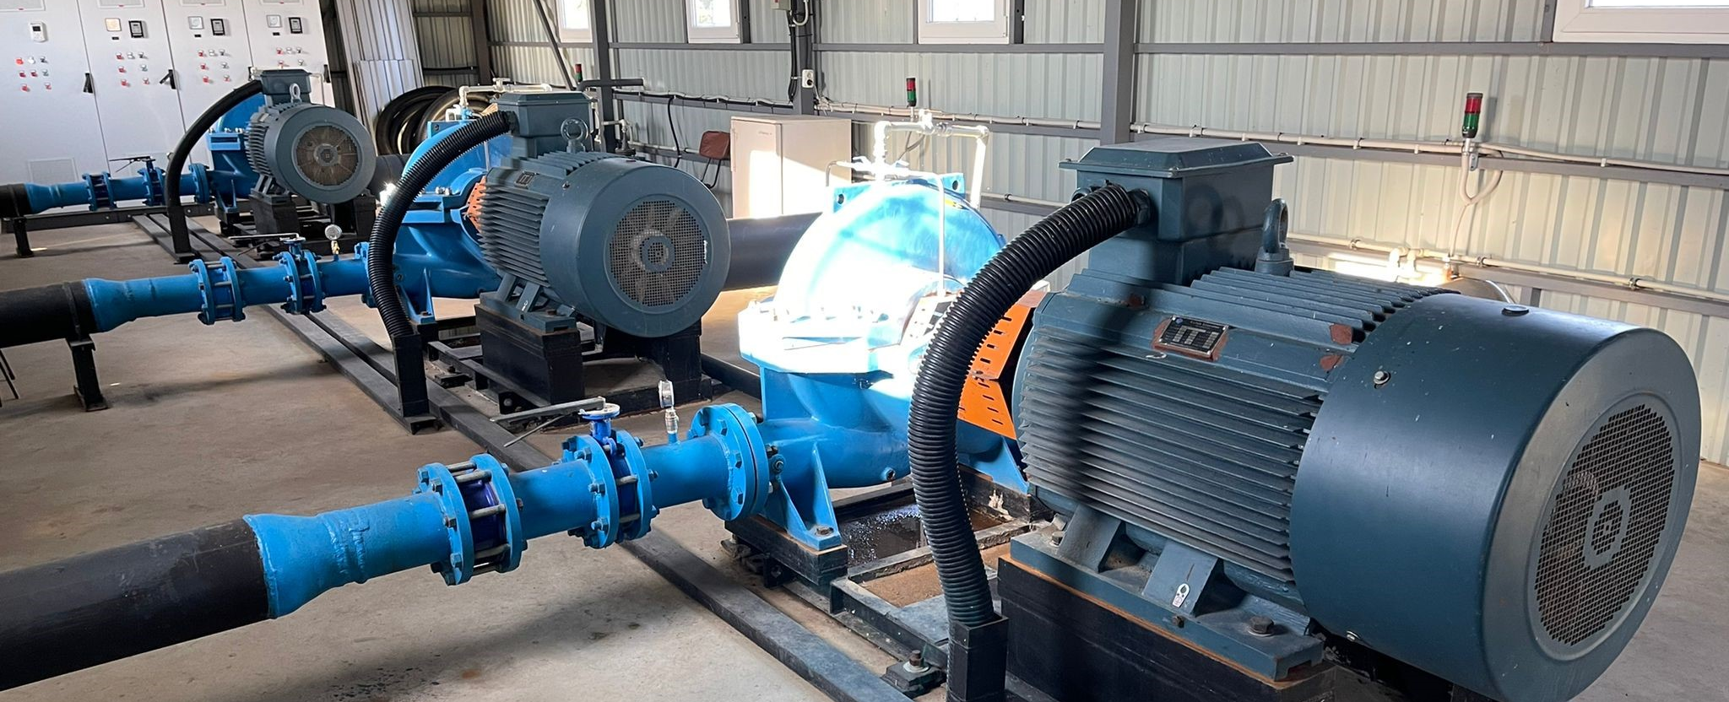
Split Case
GloTech has successfully supplied our HS series split case pumps in some high-profile projects
125HS-290 pump during construction of 220 Central Park, NYC
300HS0.41-91.5 pumps installed at the Nile River, Sudan
150HS-605 pumps installed in the Ukraine
12

Slide 13
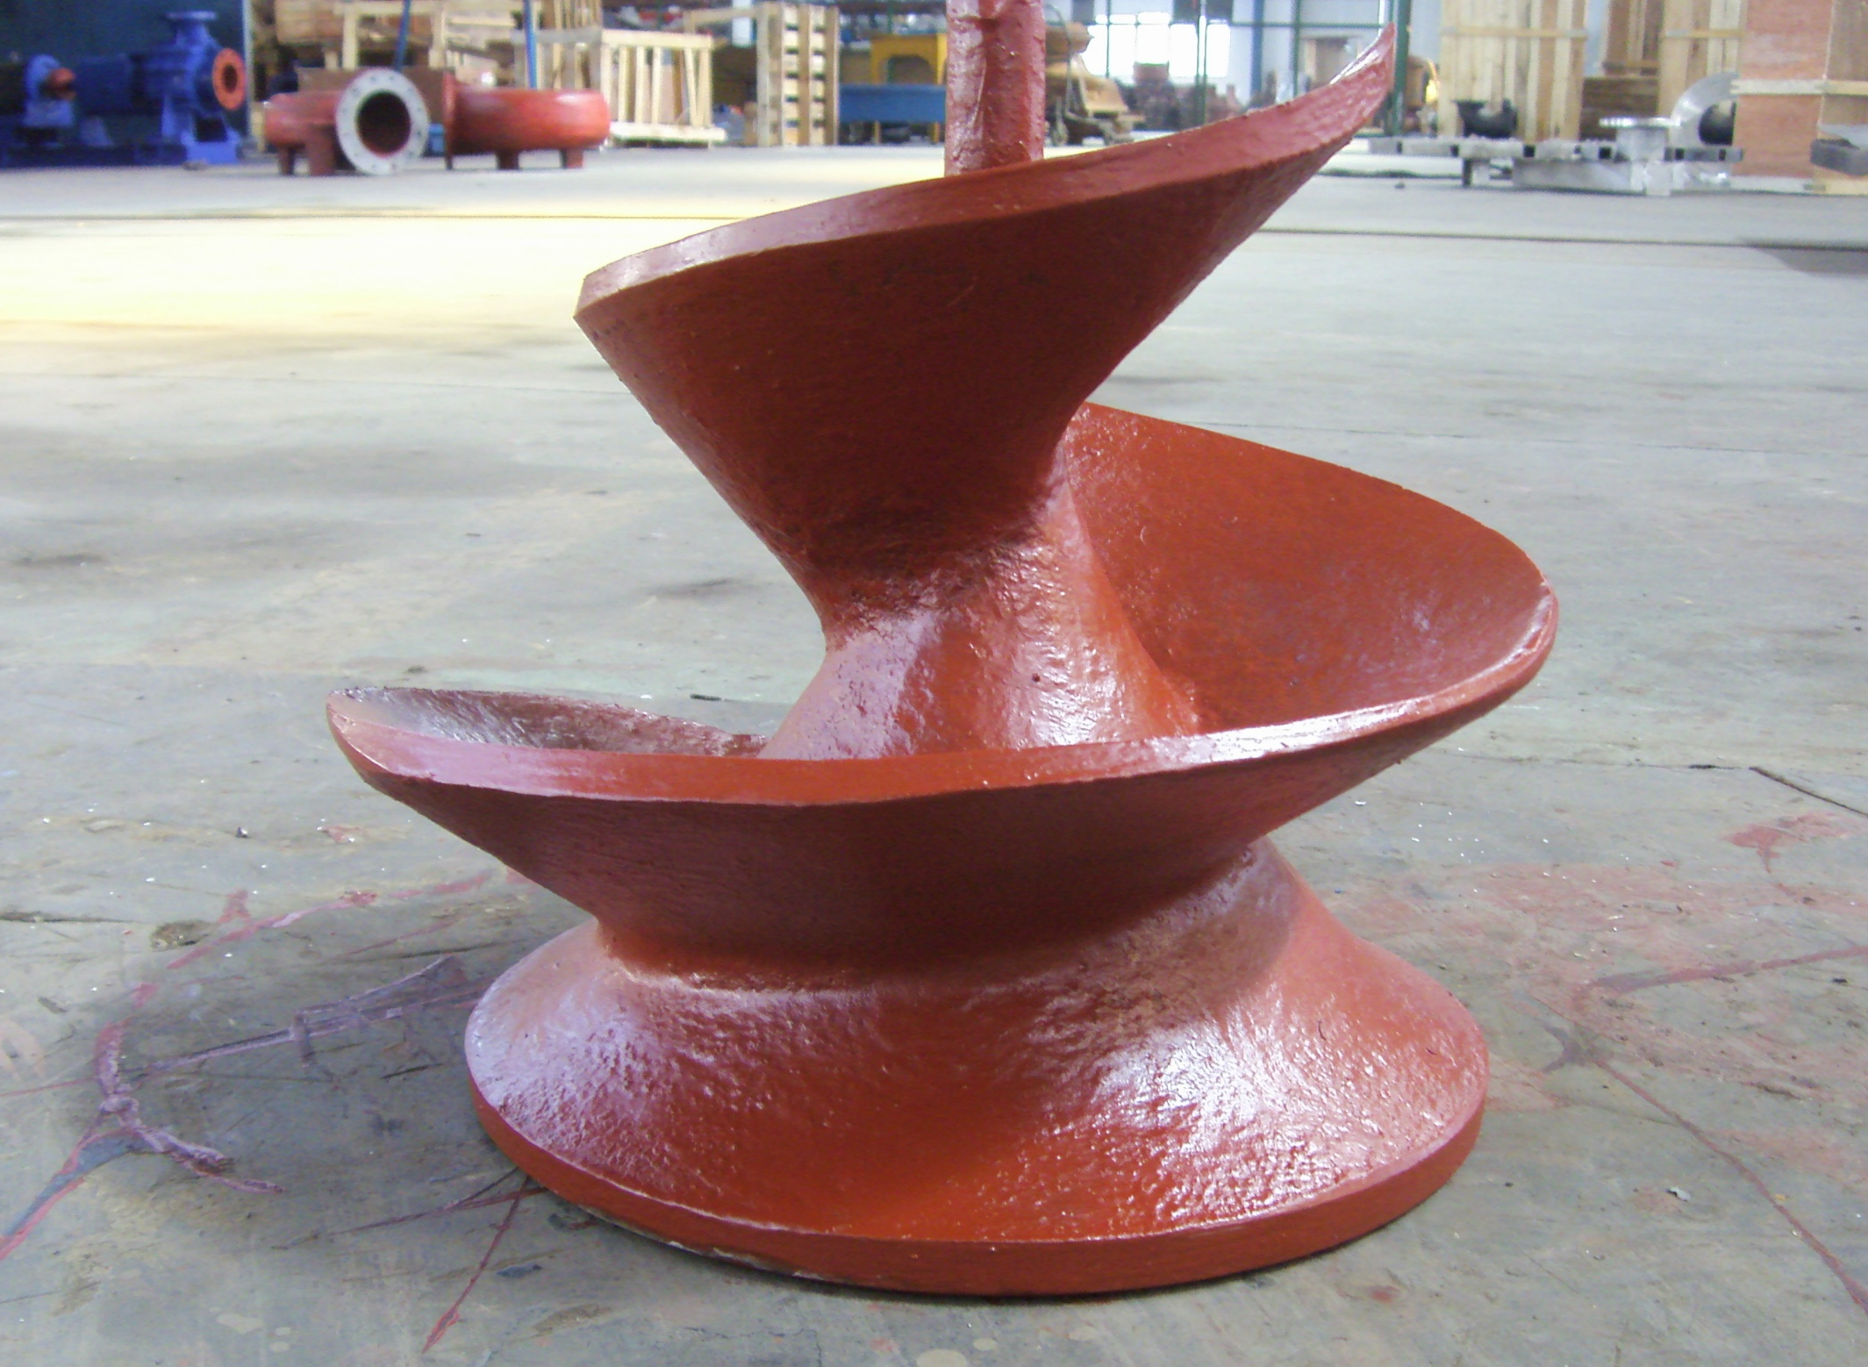
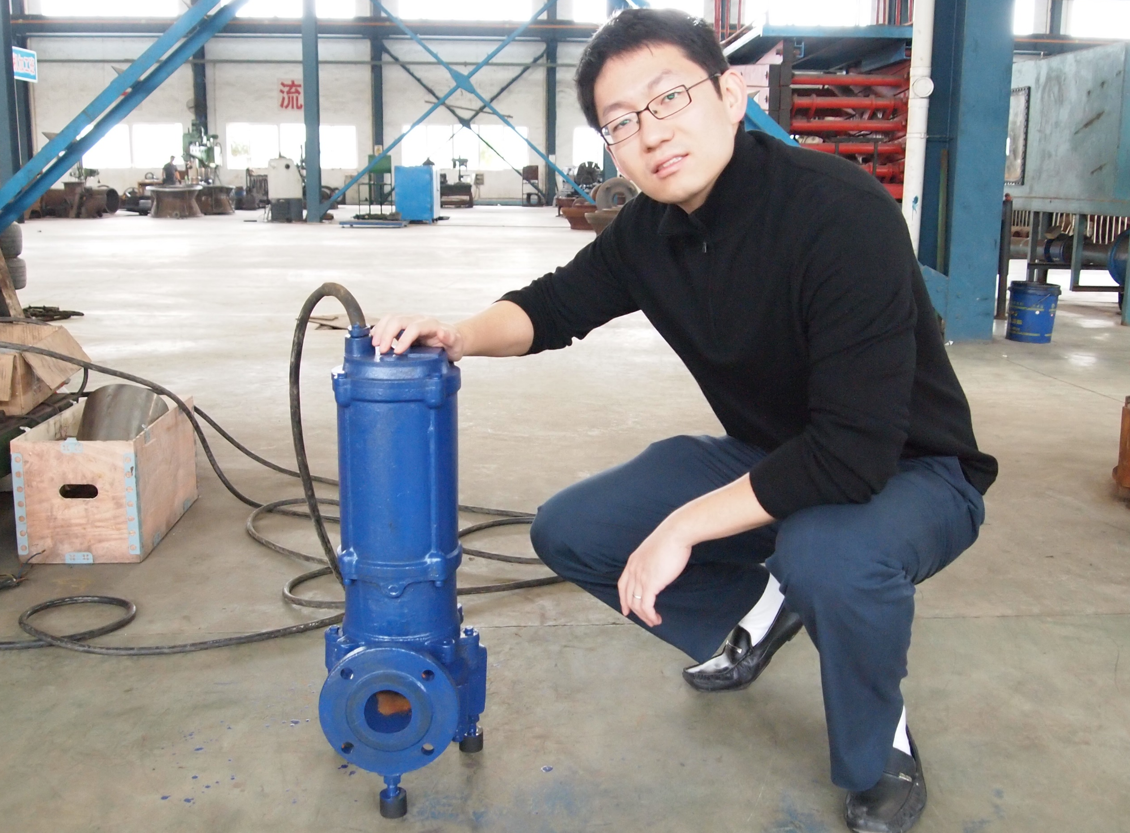
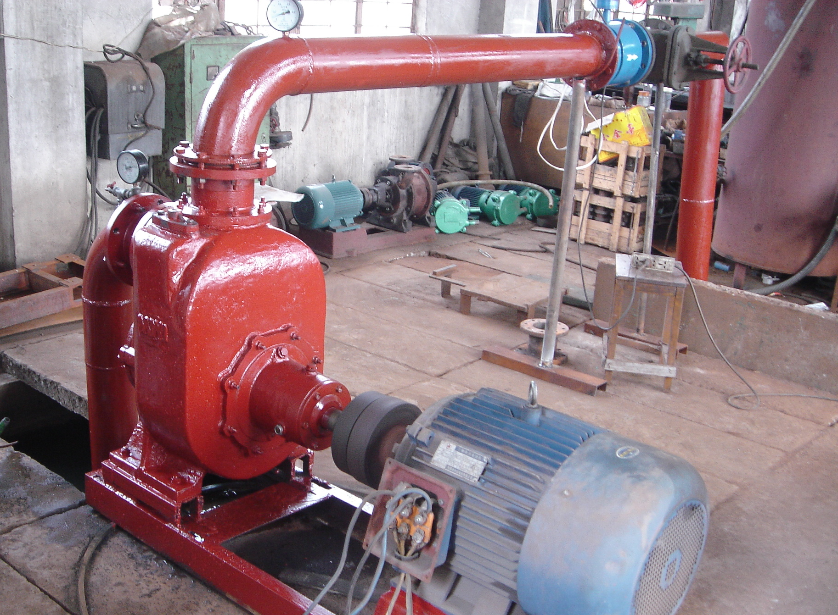
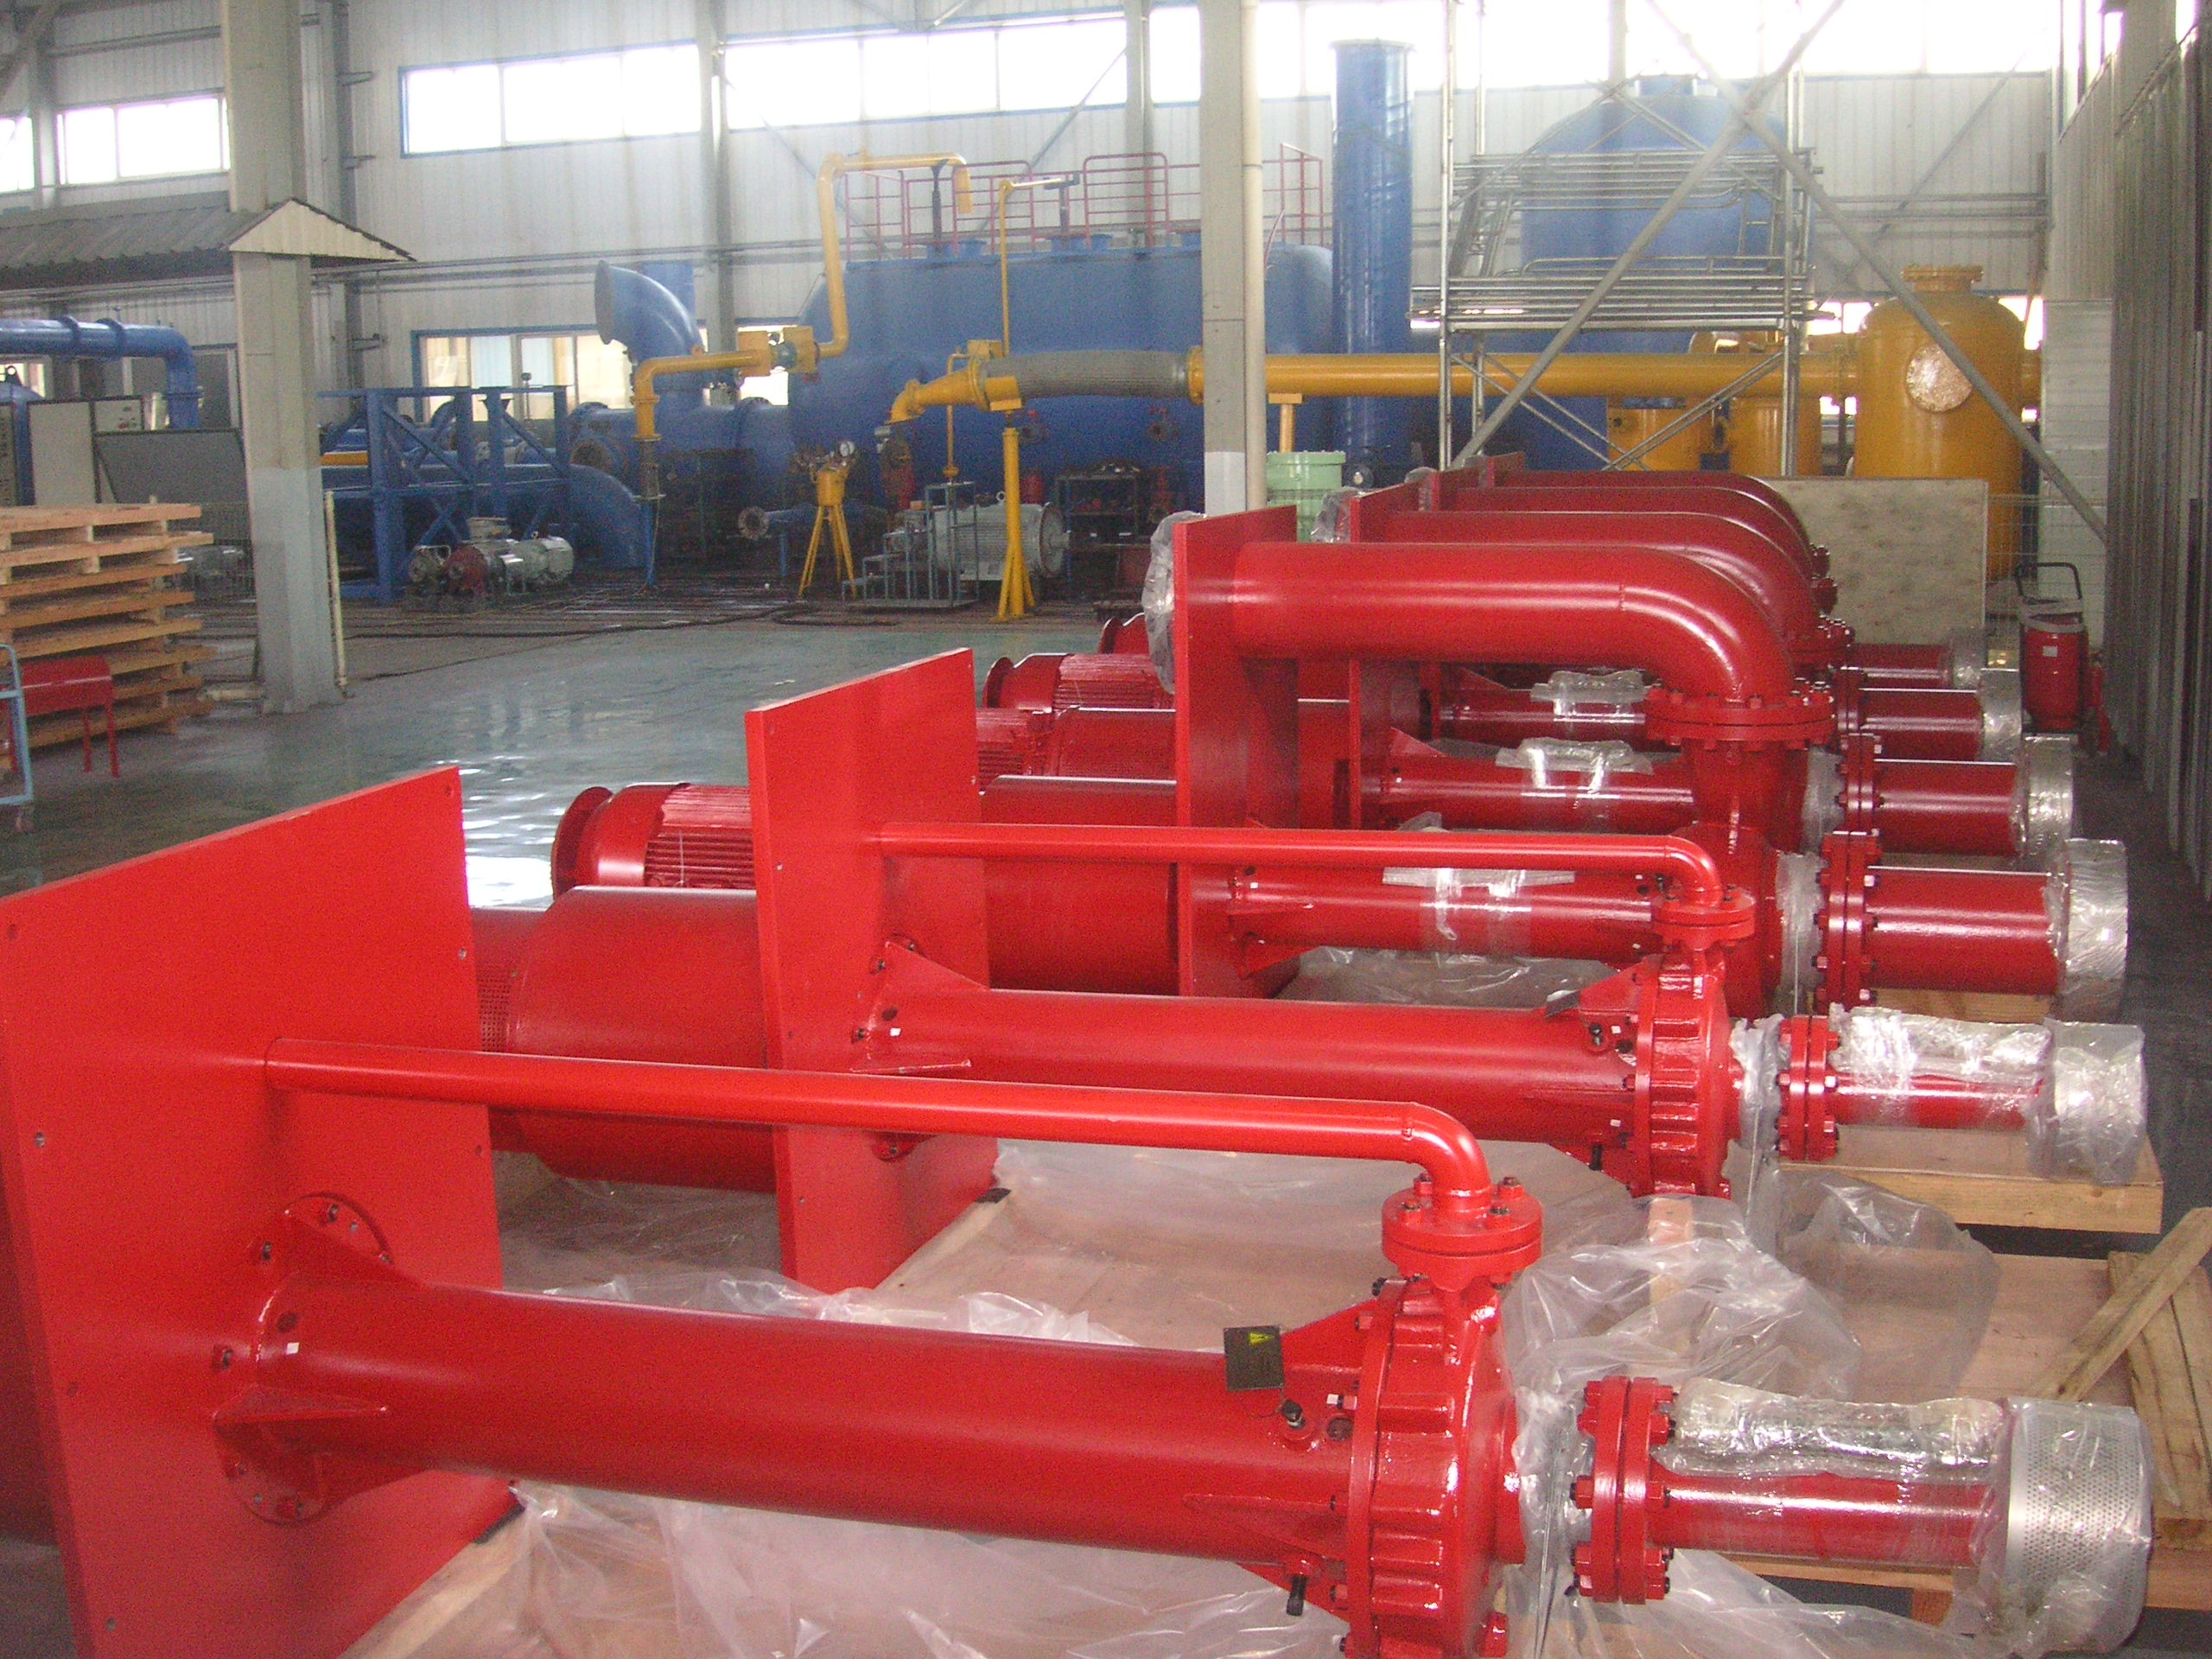
Other Centrifugal Pumps
GloTech provides large scale, engineered installations
Submersible Solids Handling Pump
Screw Centrifugal Pump
Slurry Pumps
Grinder Pump
Self-priming Pump
Vertical Cantilevered Pumps
13

