Slide 1
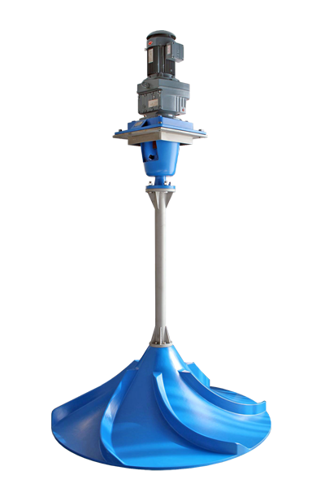
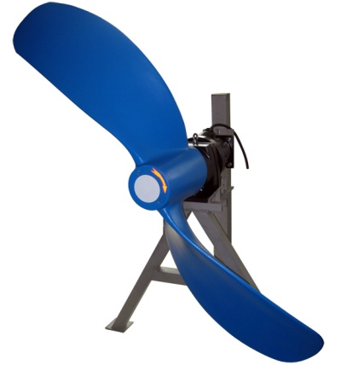
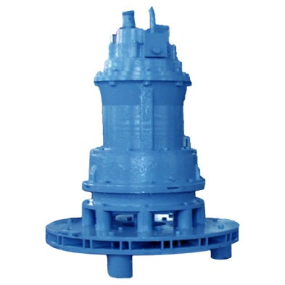
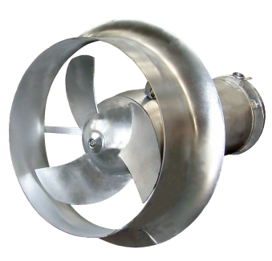
Aerators and Mixers
GloTech designs and manufactures a wide range of mixers / aerators for municipal wastewater treatment applications
TECHNICAL DATA
Mixer Sizes: 20”- 110”
Max. Flow: 90,000 gpm
Max. Speed: 200 rpm
Max. Power: 10 hp
Max. Area: 72 ft
TECHNICAL DATA
Mixer Sizes: 42”- 100”
Max. Thrust: 965 lbs
Max. Speed: 121 rpm
Max. Power: 10 hp
Max. Area: 460 ft
TECHNICAL DATA
Mixer Sizes: 8”- 36”
Max. Thrust: 90,000 gpm
Max. Speed: 1300 lbs
Max. Power: 30 hp
Max. Area: 400 ft
TECHNICAL DATA
Max. Air : 500 cfm
Max. Power: 75 hp
Max. Area: 53 ft

