Slide 1
GT Casting Process Overview
GloTech Corporation
Mark Gu
01/2023

Slide 2
Contents
Introduction
Comparisons of Metal Casting Techniques
Sand Mold Structure & Glossary of Terms
Sand Casting Process Overview
Types of Sand Used in Sand Casting
Resin Sand Casting
Shell Mold Casting
Investment (Lost Wax) Casting
Lost Foam Casting
2

Slide 3
Introduction
GloTech has deep experience with advanced metal casting techniques used on a variety of its product lines
Traditionally, sand casting has been widely used for metal castings due to cost and availability. Over 70% of the world’s metal castings are produced using the sand casting process
With the advancement of casting technology, as well as the increasing demand for better casting quality and higher production rate, casting techniques including shell cast, lost-foam, and investment (lost-wax) casting, have become increasingly popular within the industry
GloTech has deep and focused experience developing and optimizing the following casting techniques associated with iron and steel materials:
Resin sand casting
Shell casting
Investment (lost wax) casting
Lost-foam casting
3

Slide 4
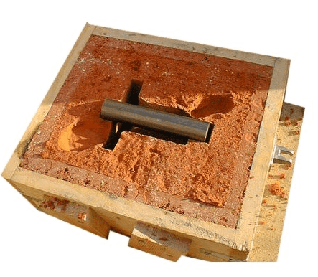
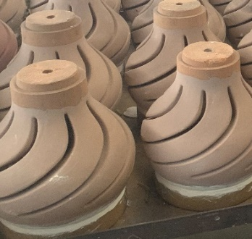
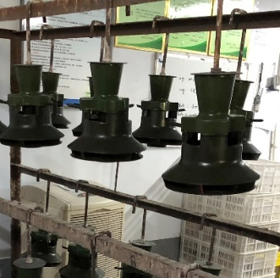
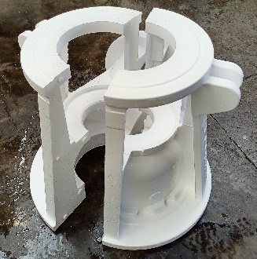
Comparisons of Metal Casting Techniques
PROs and CONs of metal casting techniques commonly used for GloTech products
Casting Process | Sand Casting | Shell Mold | Investment (Lost Wax) | Lost Foam
Tolerances | Loose | Medium (size dependent) | Tight (Accurate for small parts) | Medium
Surface Finish | Fair | Very Good | Excellent | Good
Production Volume | Low | High | High | High
Other Areas of advantage | Large parts Thicker walls | Size and weight limitations | Intricate geometry Thin wall | Large parts Medium wall thk
Pictures
4

Slide 5
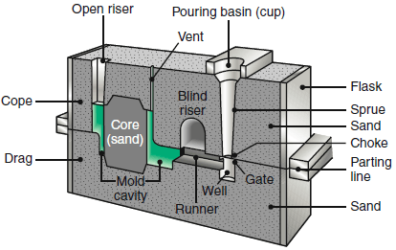
Sand Mould Structure
Typical sand casting mould cross-sectional view and glossary of terms
Sand Mold Structure
Cope: Top half of a two-part casting mold
Drag: Bottom half of a two-part casting mold
Sprue: The main channel through which molten metal flows before entering the mold cavity
Gate: The area of the runner system where molten metal actually enters the mold cavity
Runner: A channel through which molten metal is poured in order to reach the mold cavity
Core: A preformed sand shape inserted into a mold to form
the interior of a casting, or a hollow part
Riser: A reservoir to feed molten metal and control the solidification sequence
Vent: Allowing gas to escape from a mold
Draft: Taper on the vertical sides of a pattern or corebox allowing the core or sand mold to be removed without distorting or tearing the sand
Mold: A rigid frame into which liquid metal is poured to form a casting
Pattern: a replica of the part to be cast, used to shape the mold
5

Slide 6
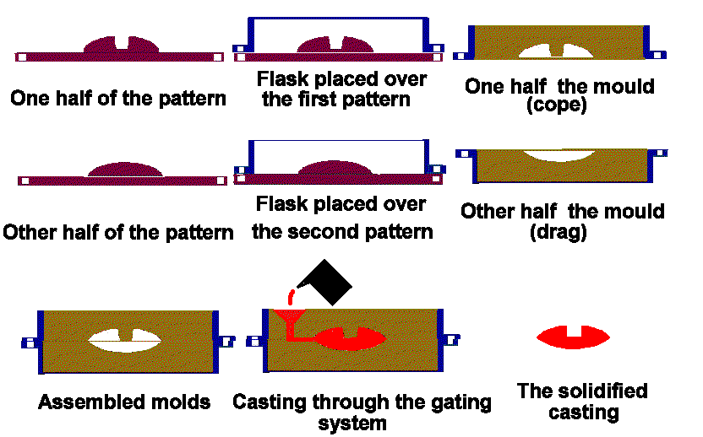
Sand Casting Process
One of the oldest and most economical processes for creating metal parts and structures
Sand Casting Process Overview
6

Slide 7
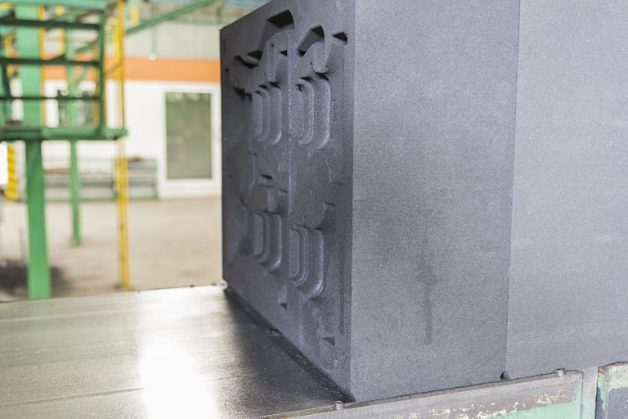
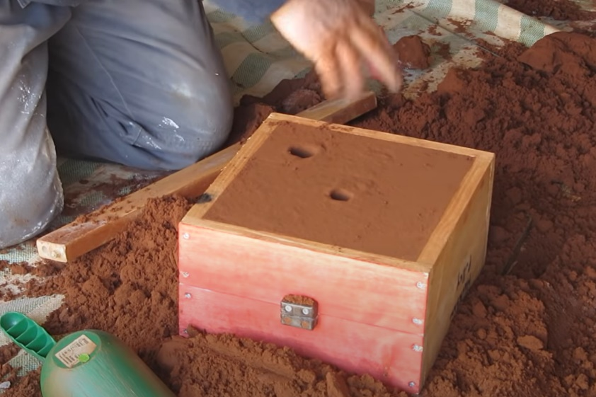
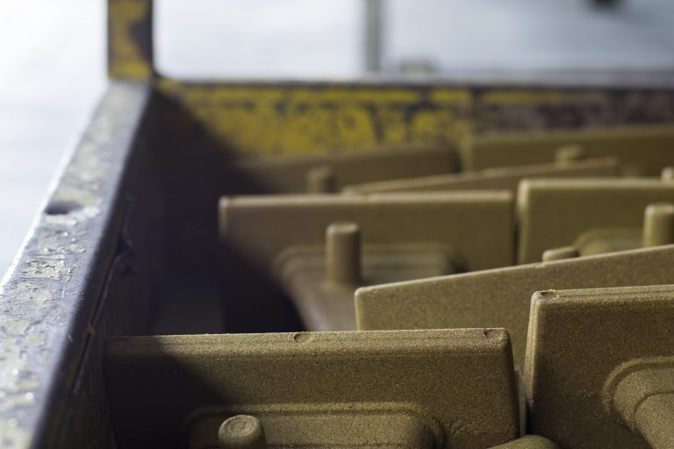
Types of Sand Used in Sand Casting
There are three types of sand commonly used in a sand casting process: green sand, water glass (sodium silicate) and resin sand
[PHOTO 1]
Green Sand
Water Glass
Resin Sand
Green Sand
A common casting process, using moist, clay-bonded molding sand
PROs:
Cost effective
CONs:
Rough surface
More casting defects (leftovers and sand holes)
Water Glass (Sodium Silicate)
Another sand mold material that requires CO2 to dehydrate
Useful where a cavity is required in casting
PROs:
Does not emit harmful or irritating gases
CONs:
Can be difficult to separate / demold
Resin Sand
The chemical reaction created by the resin helps to bind and stiffen the quartz sand to make solid, hard and strong molds
PROs:
Less faulty castings
Better surface quality
CONs:
More expensive
Lower production rate
7

Slide 8
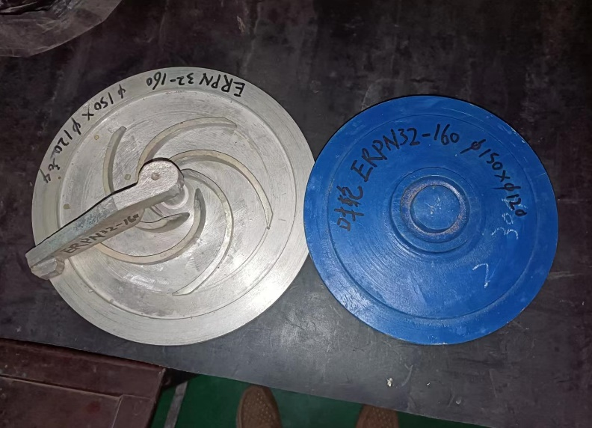
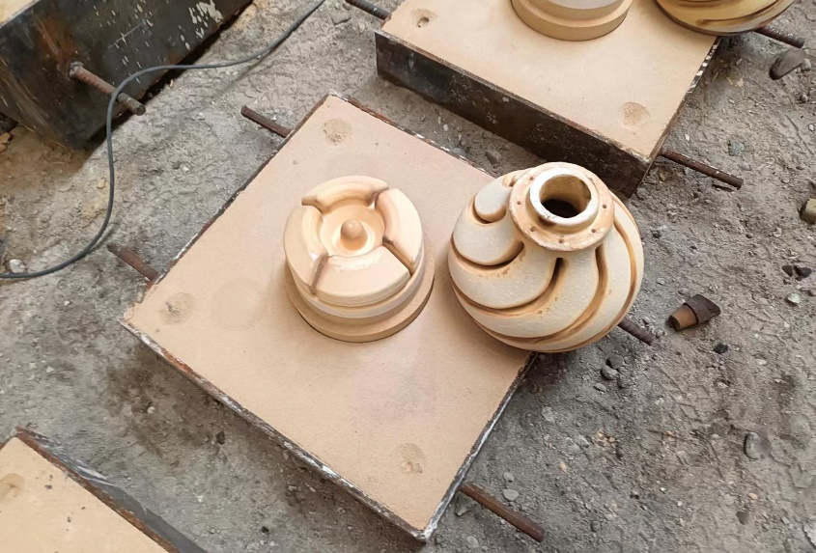
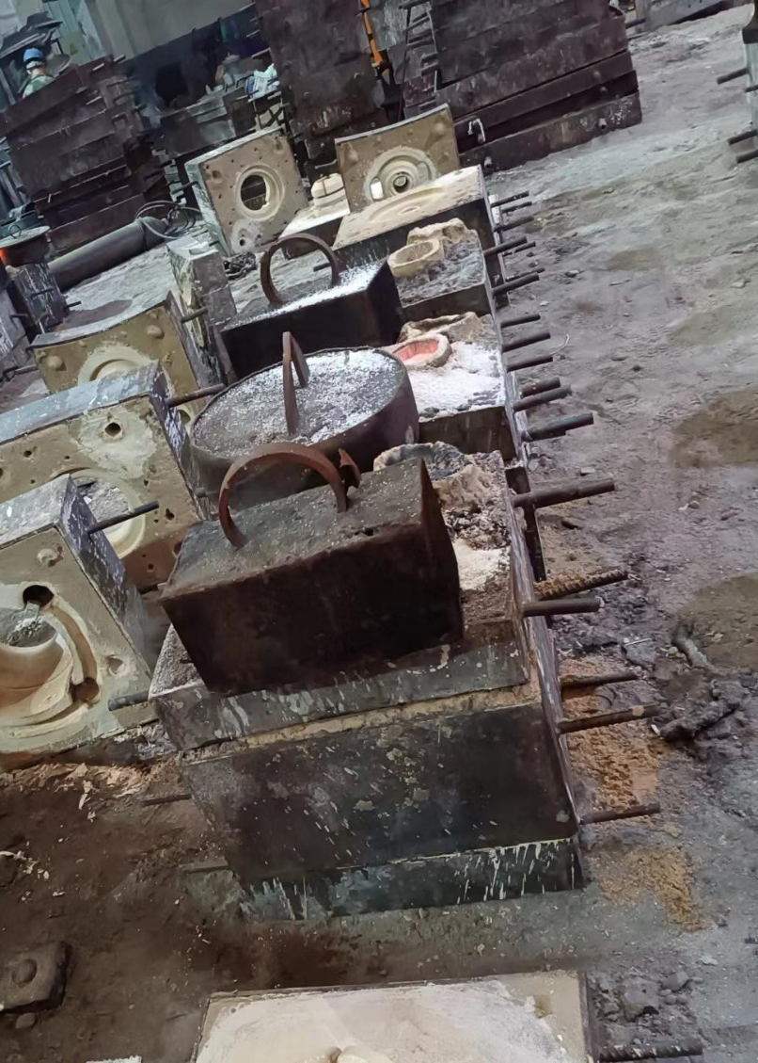
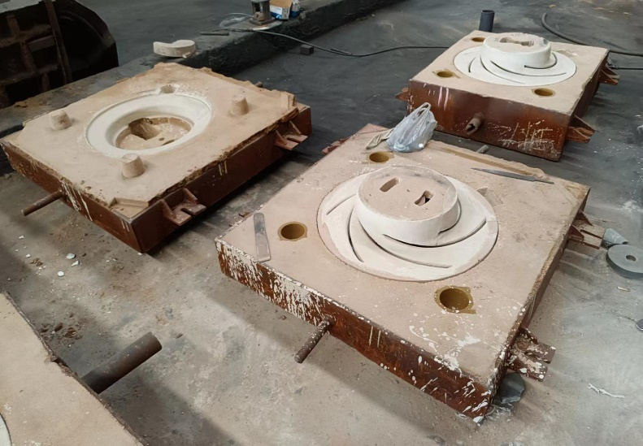
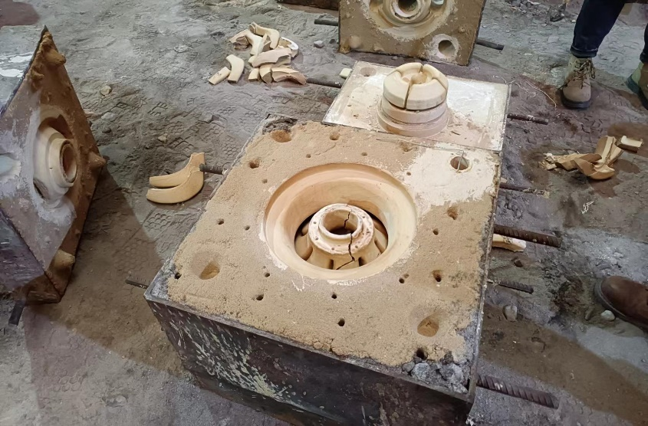
Resin Sand Casting - Case Study
Resin sand casting is commonly seen on larger castings with low-medium production volumes.
Resin Sand Casting Process
Mold/Core Production
Mold/Core Assembling
Pouring/Post Processing
Create sand mold / core using tooling / pattern
Assemble core, mold, sprue, riser, etc.
Pouring, shakeout, cutting, shot blast, etc.
8

Slide 9
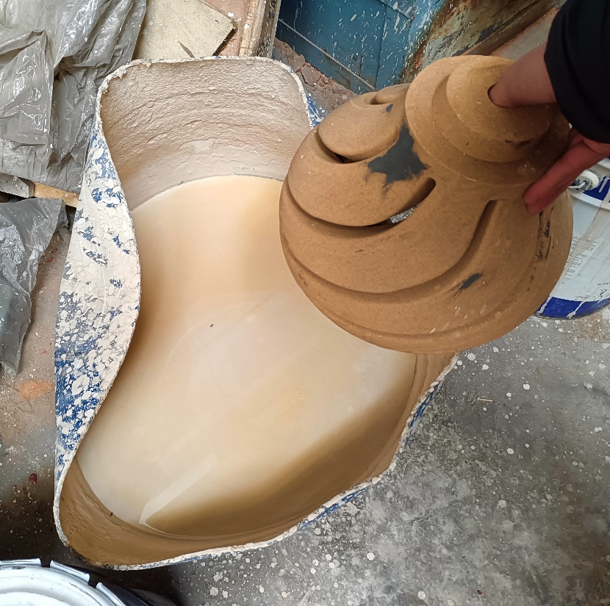
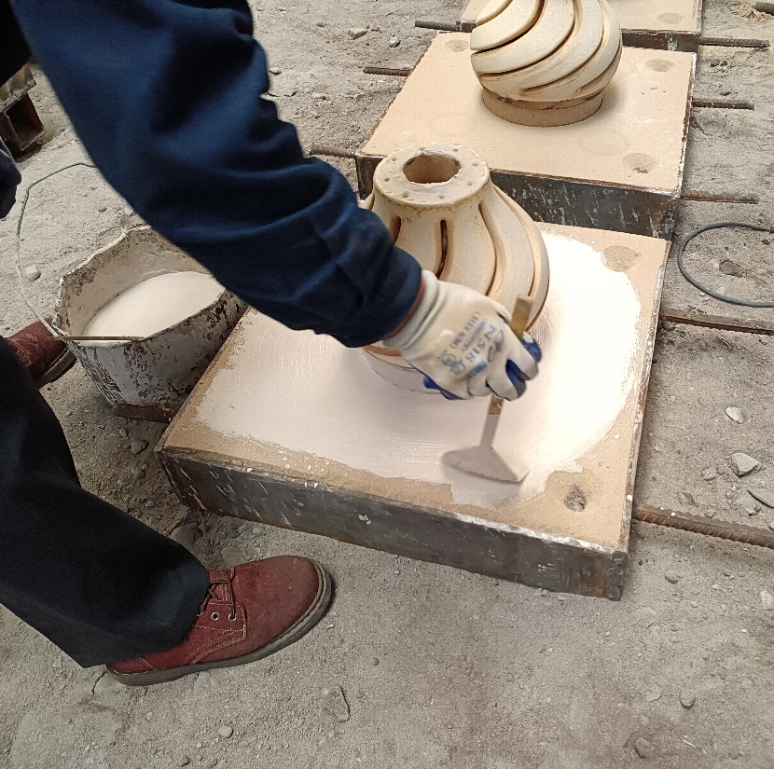
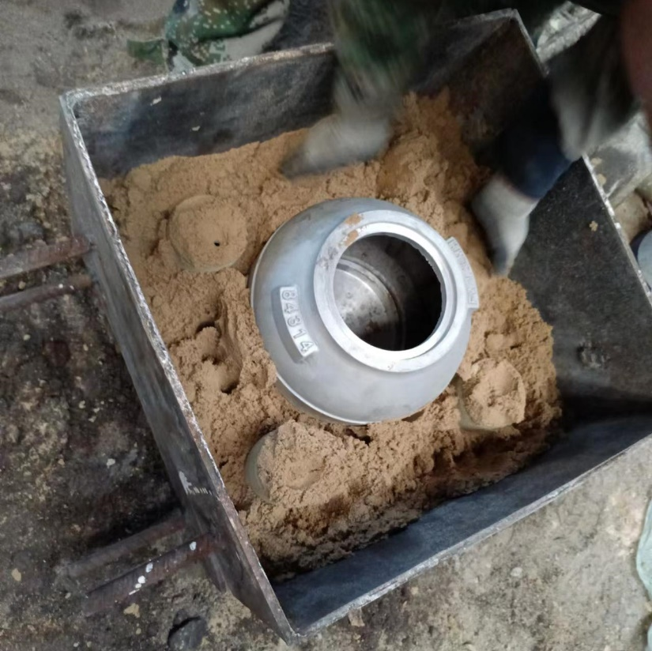
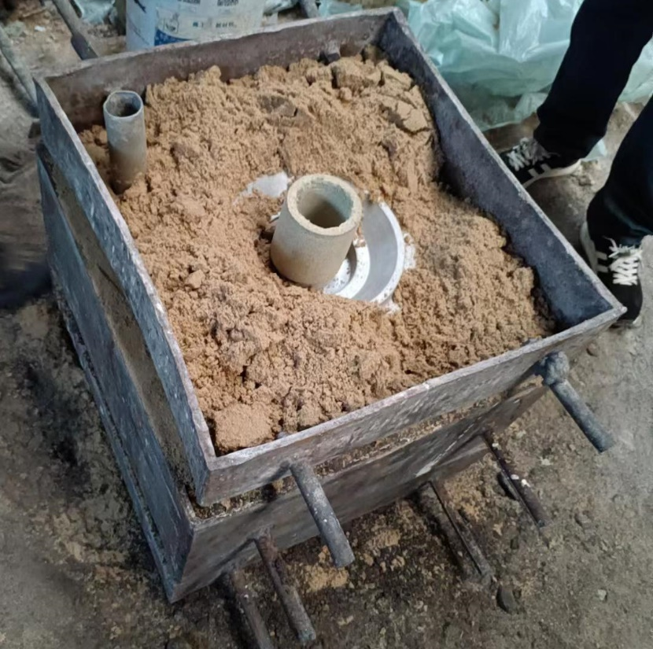
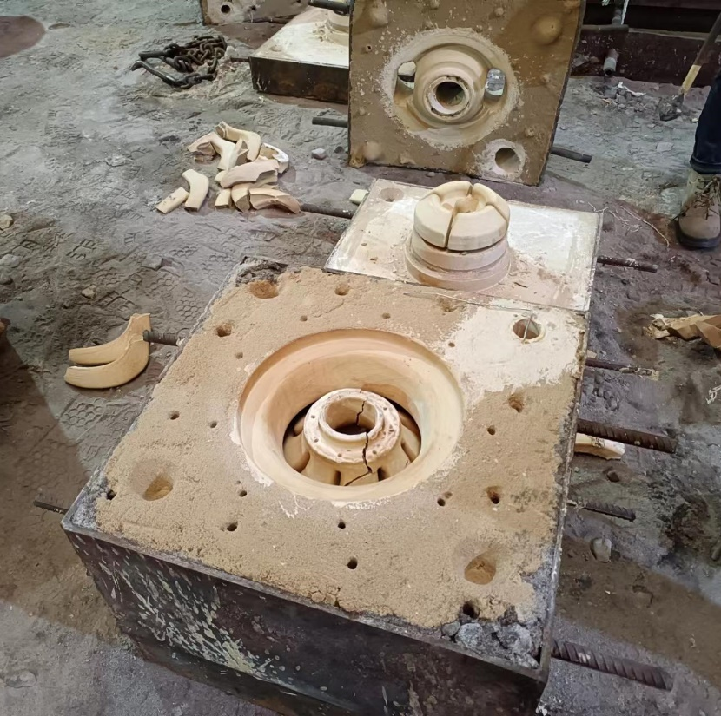
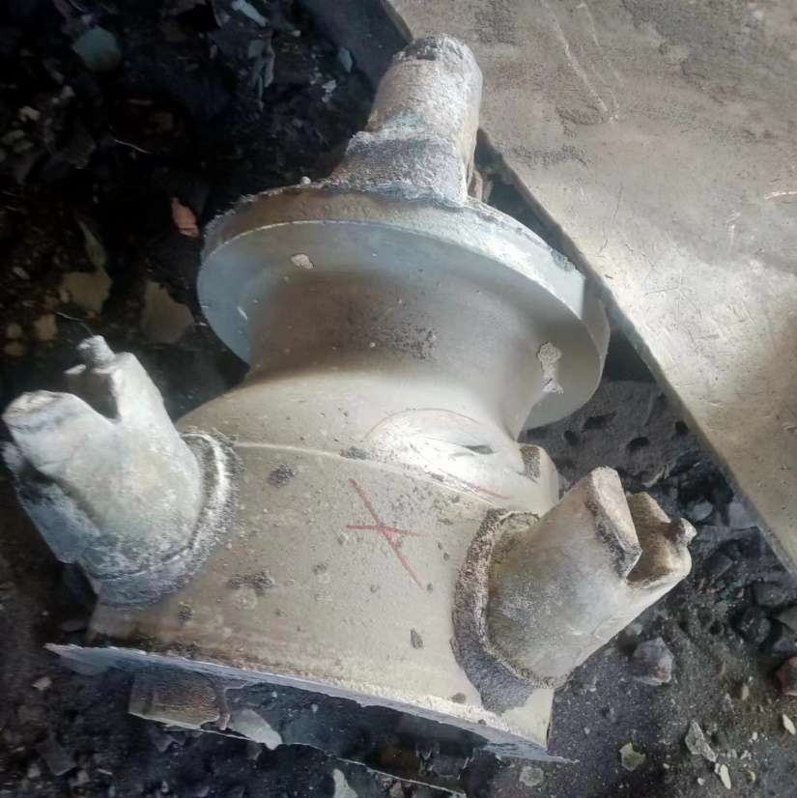
Resin Sand Casting - Case Study
Additional photos of resin sand casting process
Sand Core Dipping
Sand Core Coating
Sand Shell Molding
Sand Shell Molding
Molds Assembly
Casting with Sprue/Risers
9

Slide 10
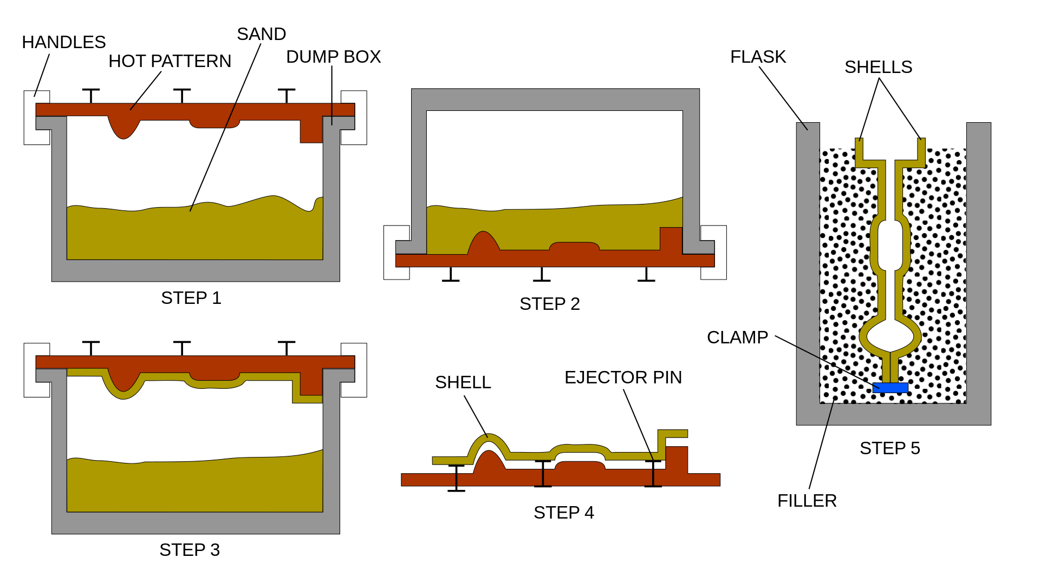
Shell Mold Casting
It uses preheated metal tooling to “bake” molds and cores with a hardened shell, which allows for a smooth casting surface finish
Shell Casting Process Overview
10

Slide 11
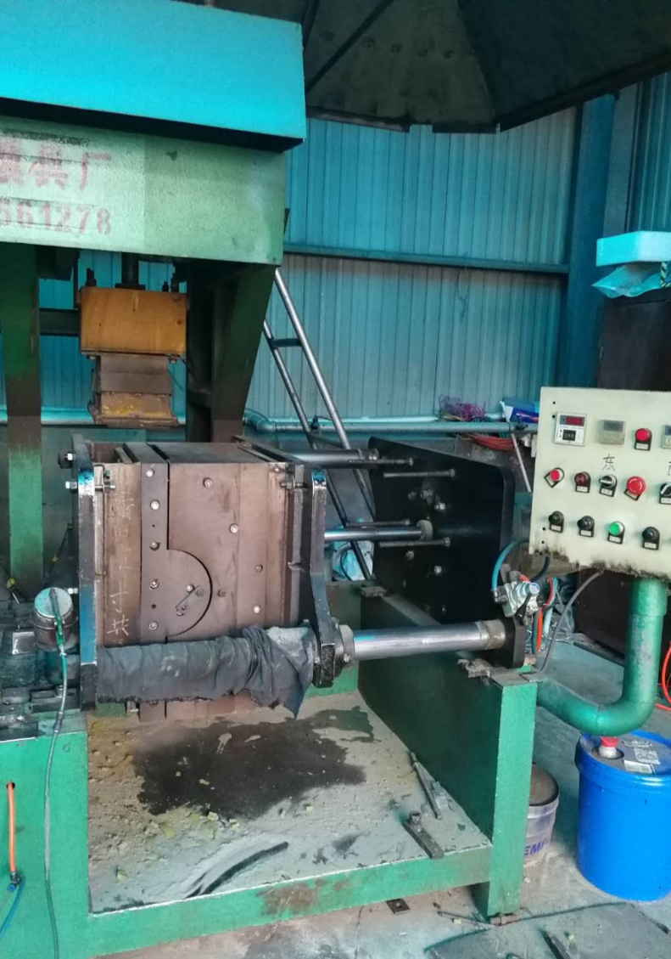
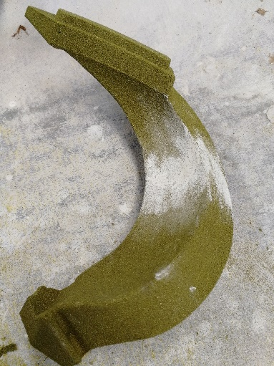
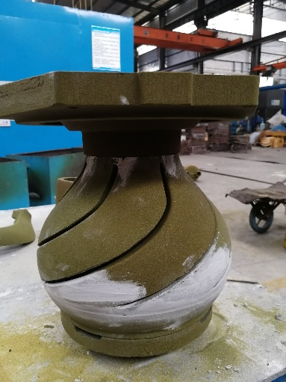
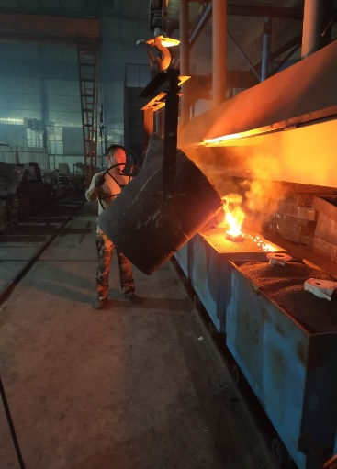
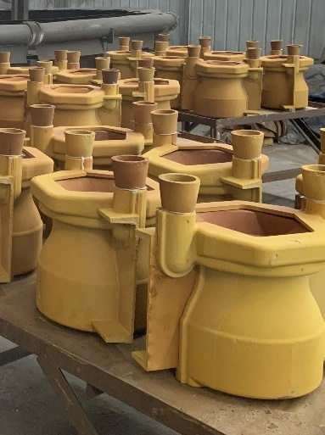
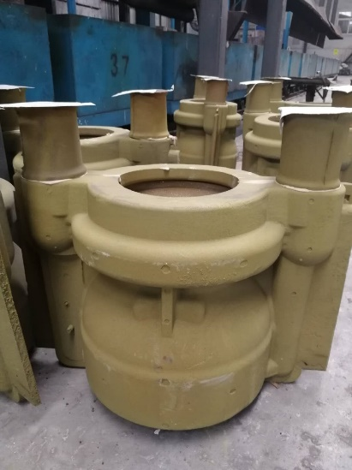
Shell Mold Casting – Case Study
Shell casting is mostly seen on small-medium castings where good surface finish is desired.
Shell Casting Process
Mold/Core Production
Shell Assembling
Pouring/Post Processing
Preheat tooling
Bake coated sand into shell
Assemble core, mold, sprue, riser, etc. via glue
Pouring, shakeout, cutting, shot blast, etc.
11

Slide 12
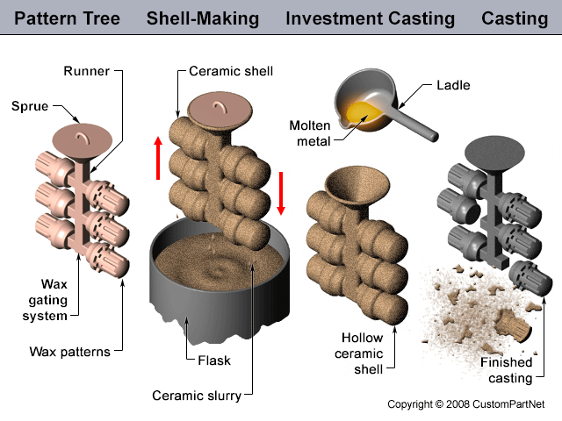
Investment (Lost Wax) Casting
As one of the oldest forms of casting, investment casting allows for greater detail and smoother finish compared to other processes
Investment Casting Process Overview
12

Slide 13
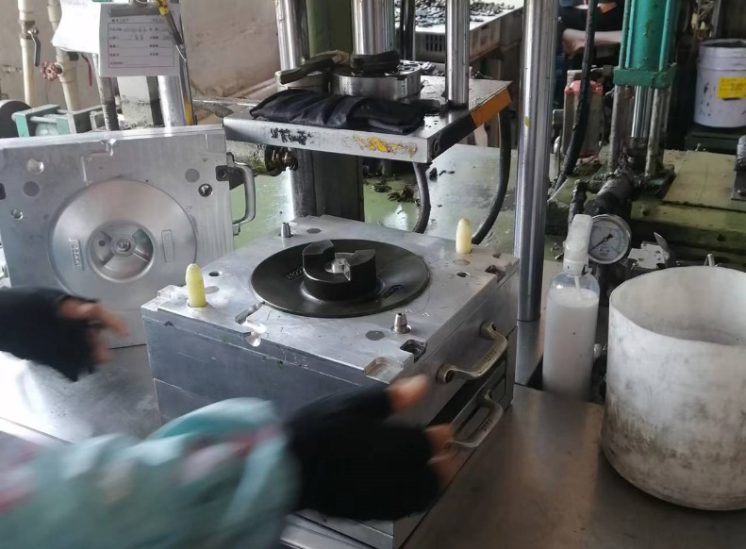
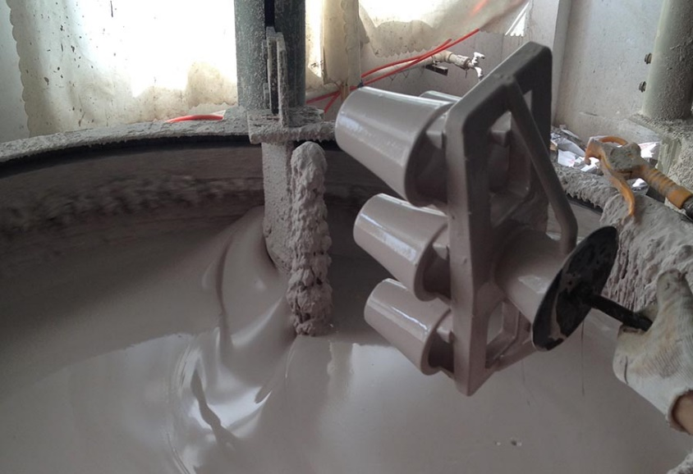
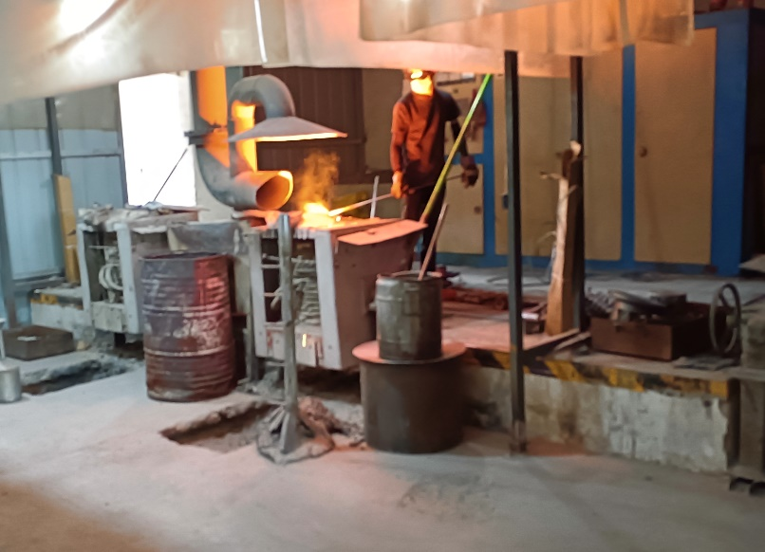
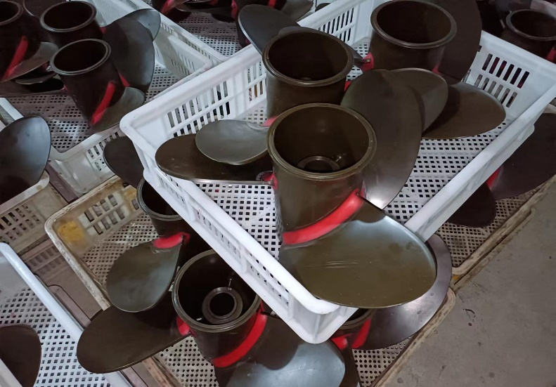
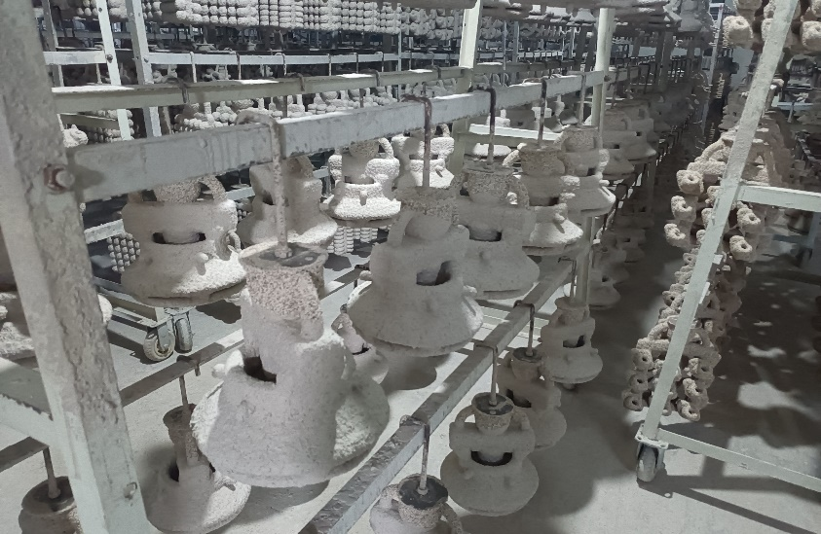
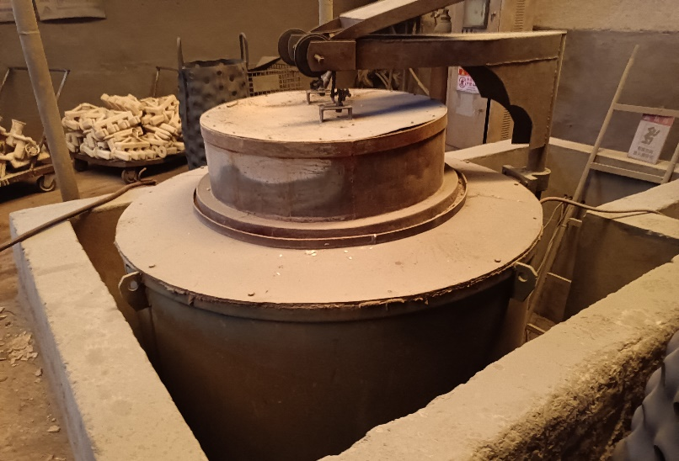
Investment (Lost Wax) Casting – Case Study
Lost wax casting is commonly seen on SS parts where appearance and hydraulic efficiency is critical.
Investment Casting Process
Wax Pattern Production & Assembly
Shell Making & Dewax
Pouring/Post Processing
Wax injection, cleaning and assembly
Slurry dipping, sand coating, dewax in autoclave
Pre-heat, pouring, shakeout, shot blast, heat treat, etc.
13

Slide 14
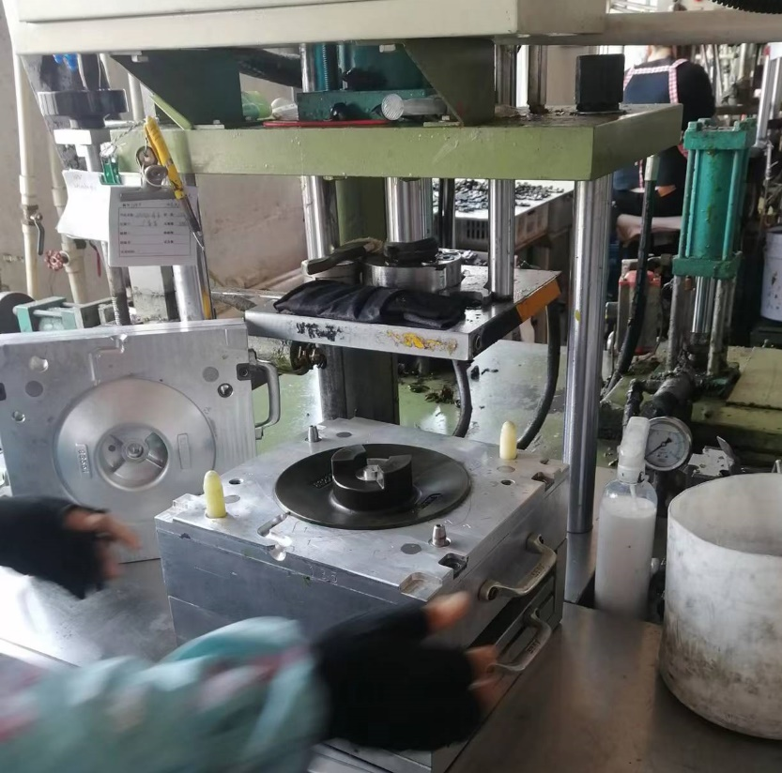
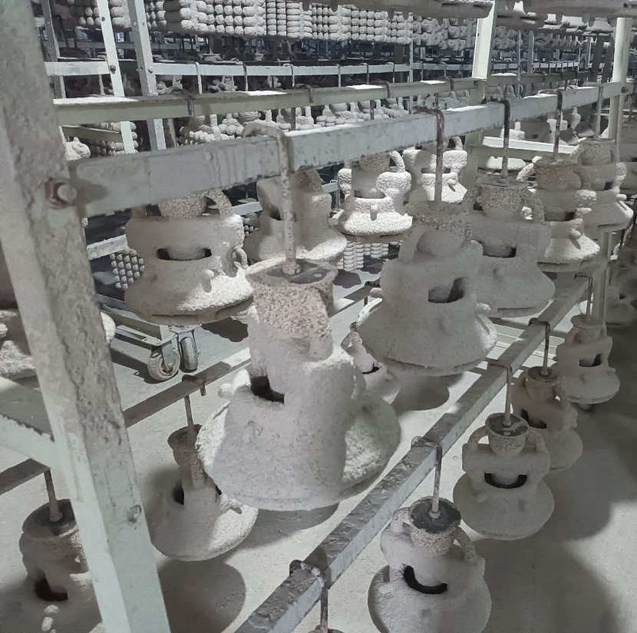
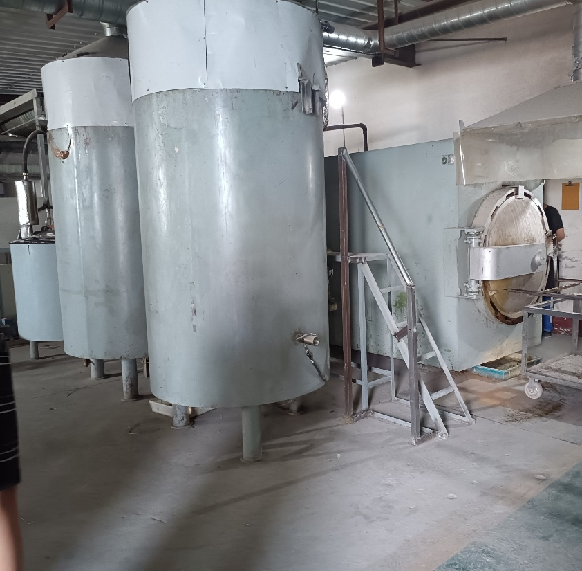
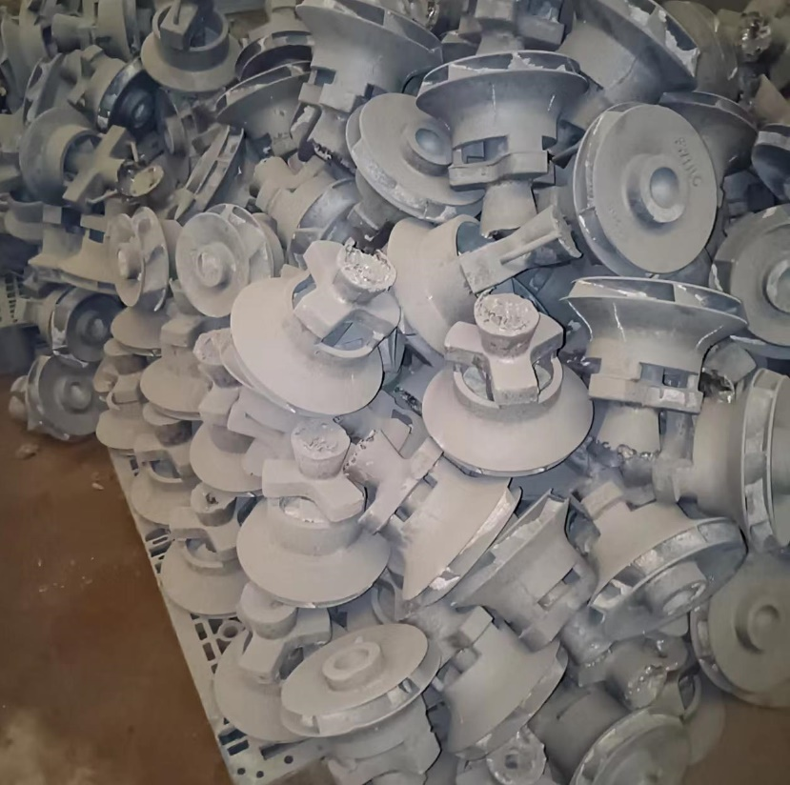
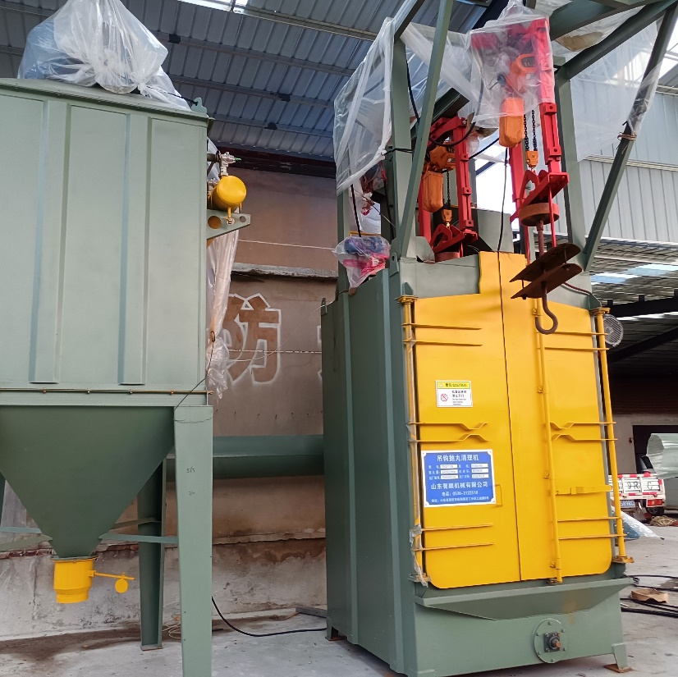
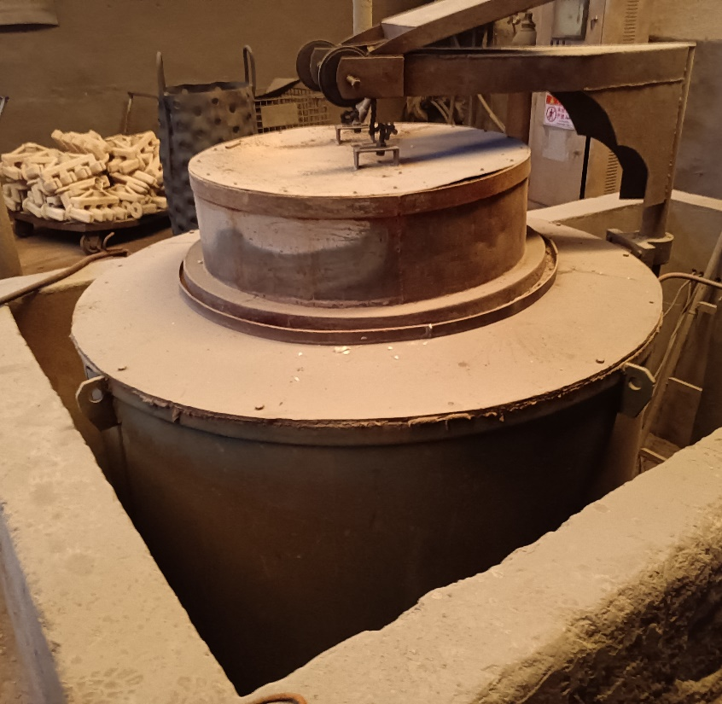
Investment (Lost Wax) Casting – Case Study
Additional photos of lost wax casting process
Wax Injection
Slurry/Sand Coats
Dewax
Machine Shakeout
Shot Blasting (<0.5mm ball)
Solution Treatment
14

Slide 15
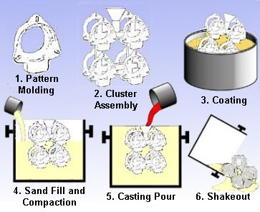
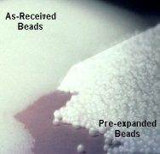
Lost Foam Casting
Lost foam casting is a process in which molten metal evaporates a foam mold being held still with sand
Lost Foam Casting Overview
Pre-expansion of EPB (Expandable Polystyrene Beads)
15
Notes:
the thinnest wall section in the casting should allow at least a three (3) bead fills wide after curing

Slide 16
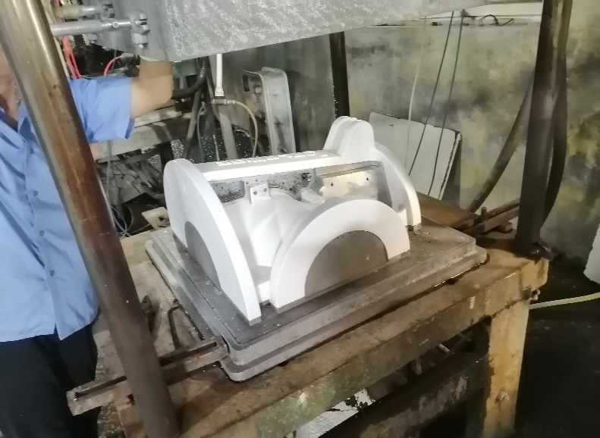
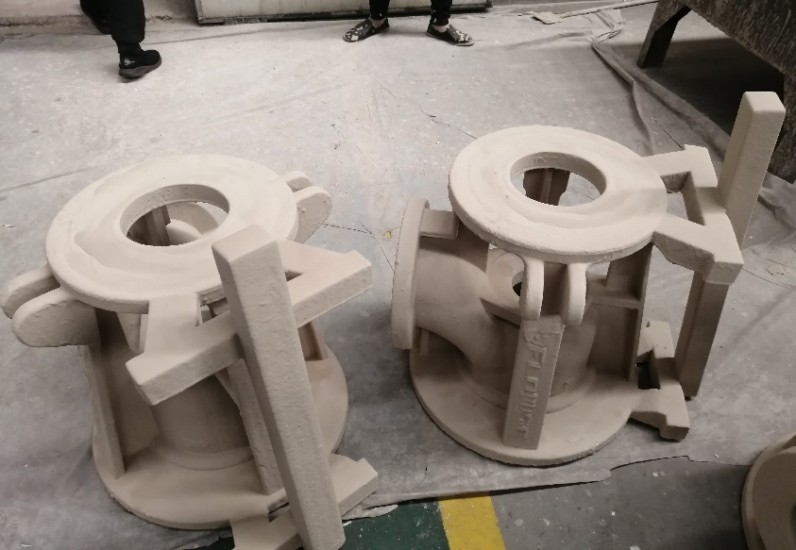
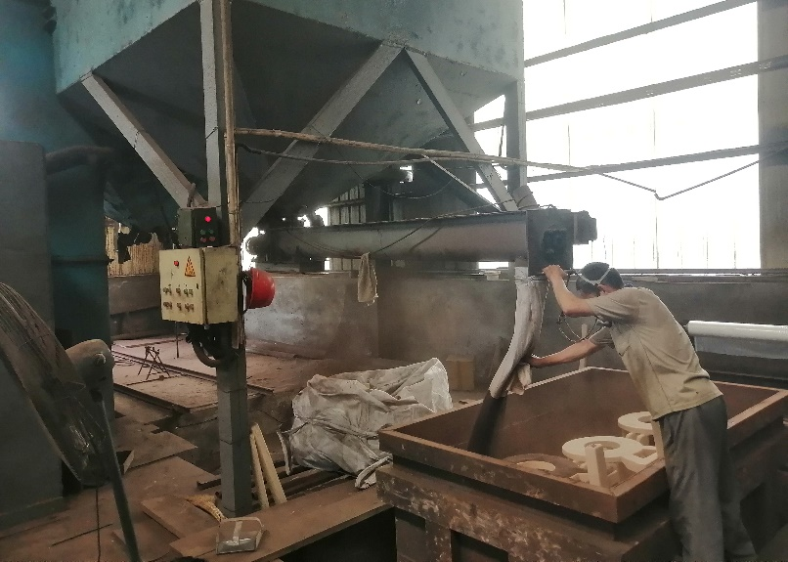
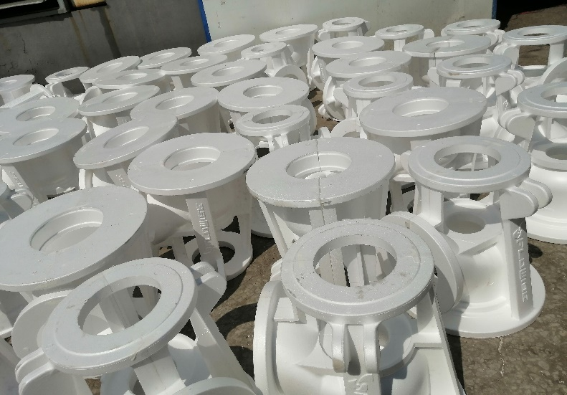
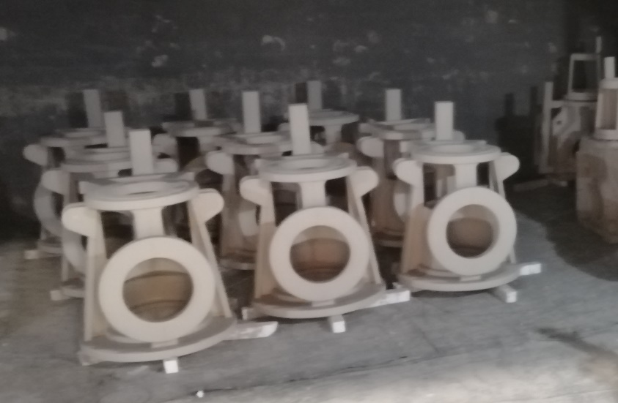
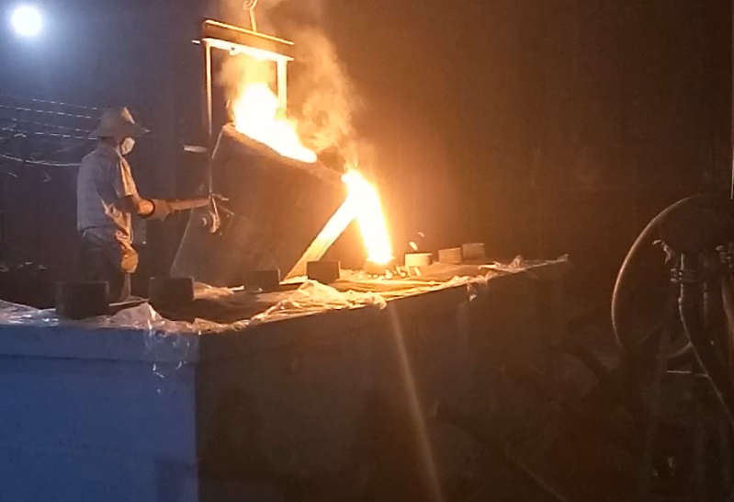
Lost Foam Casting – Case Study
With its increasing popularity, lost foam casting is ideal for large castings with high production volumes.
Lost Foam Casting Process
Foam Pattern Production & Assembly
Coating & Drying
Compaction, Pouring & Post Processing
Foam pattern molding & pattern assembly
Slurry dipping & drying
Sand fill and vacuum compaction, pouring, shakeout
16

Slide 17
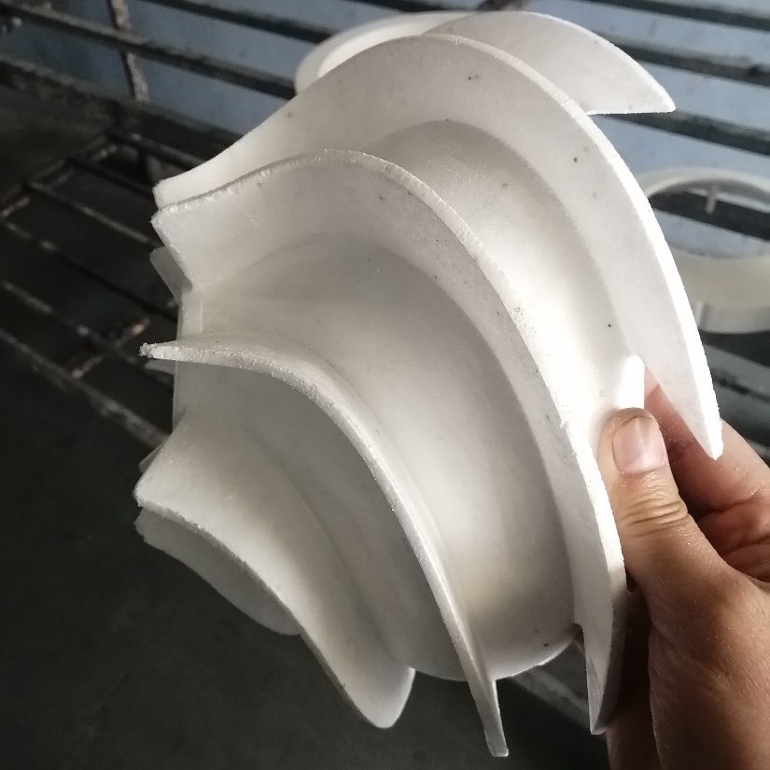
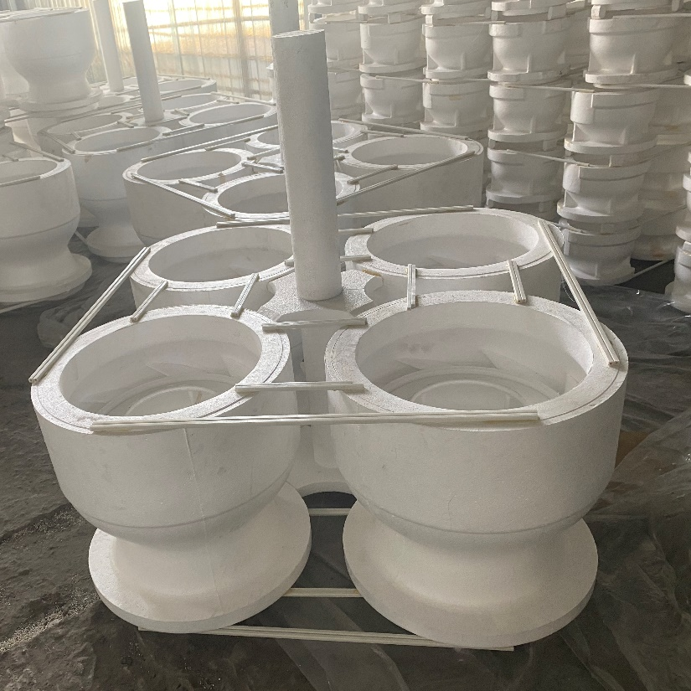
Lost Foam Casting - Case Study
Additional photos of lost foam casting process
Bowl Foam Core
Tree Assembly
Slurry Dipping
Sand Fill and Compaction
Ready for Pouring
Pouring in Progress
17

