Slide 1
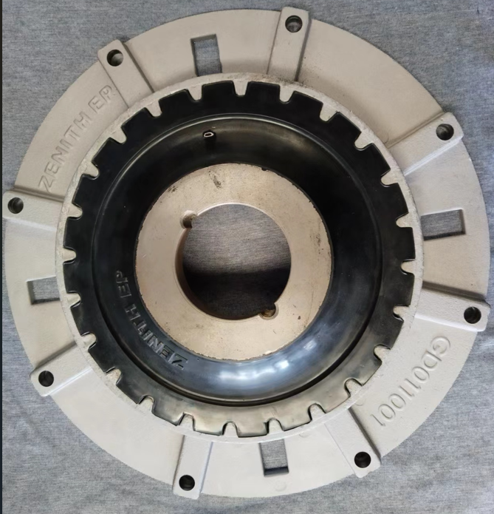
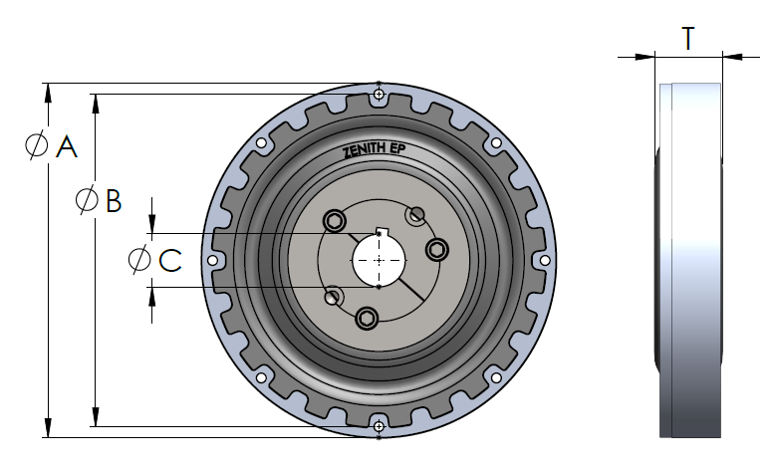
PA20000 Series
Flexible Drive Couplings
ZENITH EP
Product Overview
The PA20000 series Flexible Drive Couplings is meticulously engineered to withstand the rigors of demanding applications in construction, industrial, rental, and municipal sectors. Originally tailored for compatibility with PA2400 and PA2600 pumps, these couplings adhere to the highest manufacturing standards ensuring uncompromised quality. Constructed with premium materials, they boast the strength for torque transmission and the flexibility to accommodate misalignments and absorb shock and vibration.
Key Features
Optimized design accommodates angular, axial, and parallel misalignment between shafts, preventing wear.
Rubber designed to absorb maximum shock and vibration.
Flange dimensions compatible with SAE standard J620 and Standard Taper Lock Bushings ensure easy connection and installation with a large variety of equipment.
Additional model sizes available upon request.
Specifications
Dimensions
Model | SAE # | Overall OD “A” | Bolt Hole Dia “B” | Shaft Size “C” | Thickness “T”
C20065 | 6.5 | 224.0[8.82] | 200.0[11.63] | 50.8[2.00] | 41.0[1.61]
C20010 | 10 | 314.3[12.37] | 275.0[10.83] | 50.8[2.00] | 37.0[1.46]
C20115 | 11.5 | 352.4[13.87] | 333.4[13.13] | 50.8[2.00] | 52.0[2.05]
C20014 | 14 | 468.0[18.43] | 438.2[17.25] | 69.9[2.75] | 90.0[3.54]

